Slide 1
CH. 13/Sec. 1
The Roman Empire

Slide 2
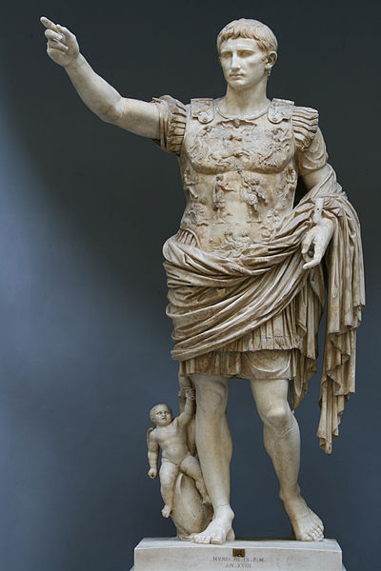
Augustus
Considered the best Roman emperor:
Brought peace to Rome
Monarchy; but still had a senate
Shrank the army; raised pay
Fought corruption
Stimulated the economy
After his death he was deified
declared a god

Slide 3
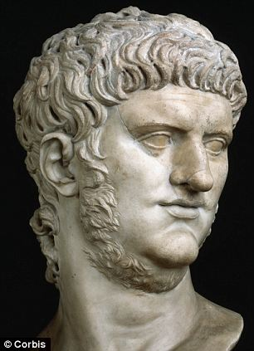
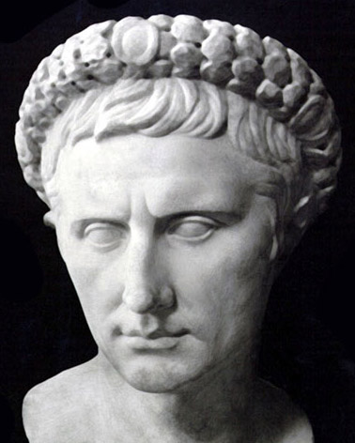
Tiberius took over after Augustus
Stepson
Nero
Considered a failure as an emperor
Killed many Roman citizens and close relatives
1st emperor to persecute Christians
http://www.history.com/topics/ancient-history/nero

Slide 4
Pax Romana
Augustus rule brought peace = Pax Romana
Latin for peace
Lasted from 30 B.C. to 180 A.D.
No major wars threatened peoples lives
Changes under Augustus:
new roads, buildings, water systems, single system of money, police and fire protection

Slide 5
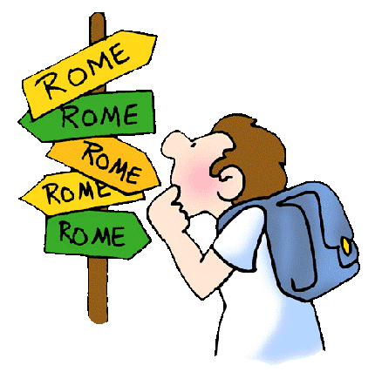
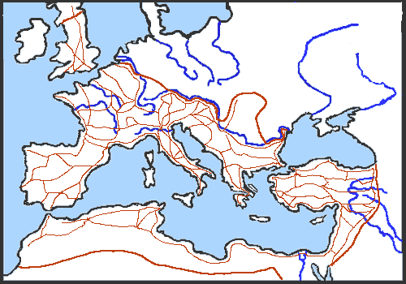
Roman Roads
“All roads lead to Rome”
Major roads extended out from Rome
50,000+ miles of road
Soldiers could march quickly from place to place.
Roman soldiers worked on the roads when not fighting
Sped up communication through the empire
Some are still used today
Superbly engineered

Slide 6
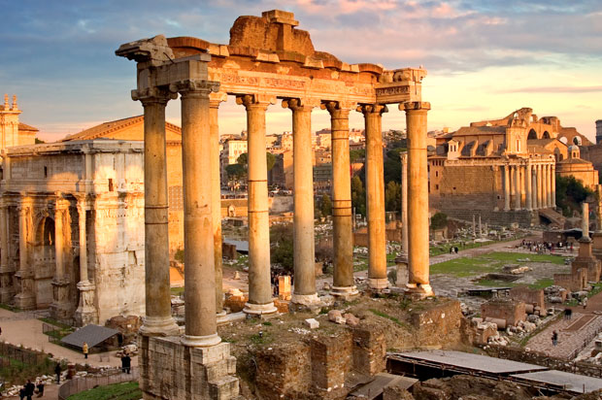
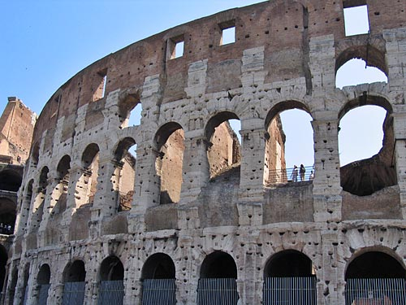
Architecture
Concrete was a new material developed to build with.
Mixed small stones and sand with limestone, clay, and water.
The mixture was then poured into a mold
Easier to work with than stone
Built large structure, domes, bridges, and arches

Slide 7
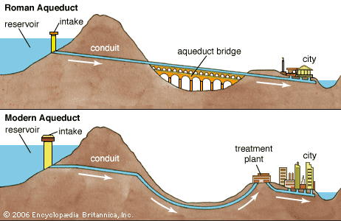
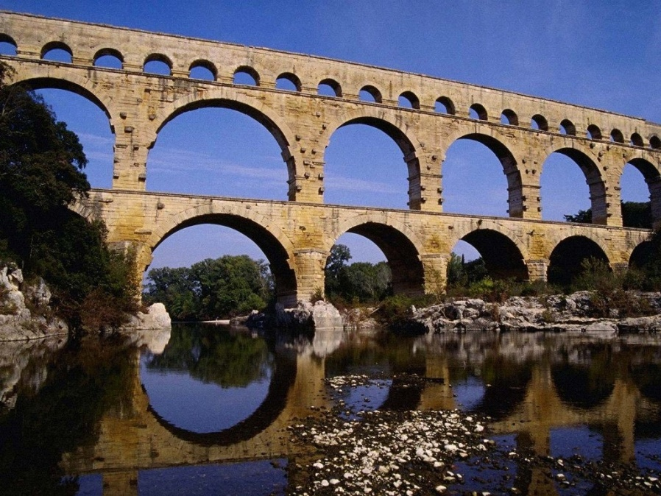
Aqueducts
Roman engineers designed water systems
Supplied towns with clean water.
Aqueduct: channel that moves water over land.
Water flowed into public fountains
Into homes
Public baths
Also carried waste
http://www.history.com/shows/mankind-the-story-of-all-of-us/videos/mankind-the-story-of-all-of-us-aqueducts

Slide 8
Trade
Piracy made water trade dangerous
Romans cleared the sea of pirates
Ships carried grain, wine, olive oil, and pottery.
Farmers grew rich from trade
Craft workers: produced cloth, glass, pottery, metalworkers, and ships.

