Slide 1
Roman Culture & Its Legacy
Ch. 13/Sec. 2

Slide 2
Art
Art filled buildings and homes of the rich
Mosaics became popular
Design formed with small tiles of glass, stone, or pottery.
Statues of gods, heroes, and important people.
Located in market places, temples, public buildings
Over 2000 fountains in all, more than any city in the world

Slide 3
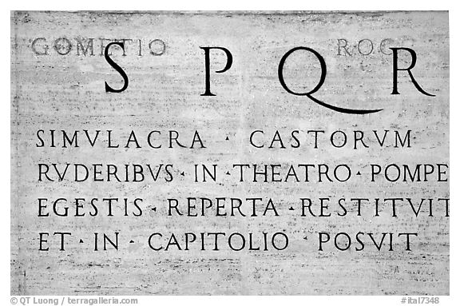
Latin
Roman language
Spread throughout Europe
Language of education in Europe for many centuries
Served as the language of the Catholic Church till the 1900s
Scientists still use it today to name plants and animals
Eventually changed into new languages
Romance Languages--group of modern languages that evolved from spoken Latin between the 6th and 9th centuries A.D
Spanish, Italian, French, and Portuguese

Slide 4
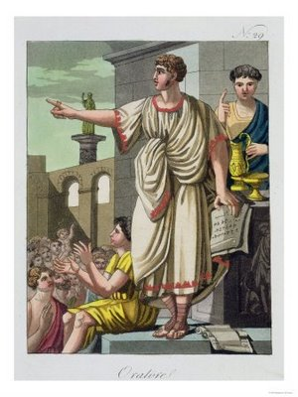
Literature & Science
Romans developed oratory
The art of giving speeches
Developed satires
Comedic literature; making fun of a subject

Slide 5
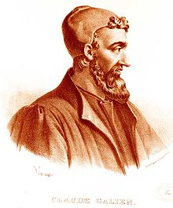
Science & Medicine
Claudius Galen
Best known Physician
Dissected animals to study how the body worked
First to discover that arteries and veins carry blood

Slide 6
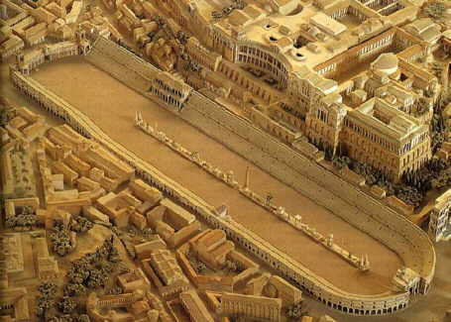
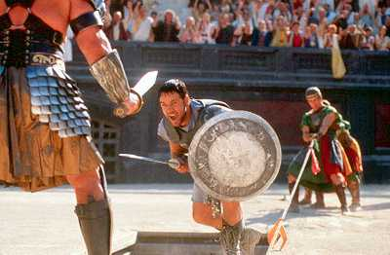
Popular Entertainment
Plays and athletic events
Massive scales
Invented the round amphitheatre and stadiums
Circus Maximus
Held chariot races
Could seat 270,000 people
Horses would pull chariots around 7 times
Gladiator Games
Men who fought one another to the death for entertainment
Games were originally staged at funerals as a sacrifice to the deceased.
Gladiator means swordsman
Gladiators were slaves or criminals that could win their freedom
Huge battle scenes were staged; even flooded the arena to have naval battles
Fought exotic animals
http://www.history.com/topics/ancient-history/colosseum

Slide 7
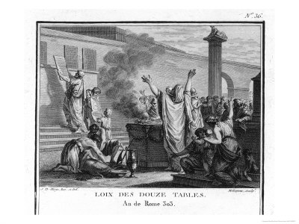
Roman Law
Originally laws were not written down
Based decisions on tradition
Twelve Tables
First written laws in Rome’s history
Set laws on family, property, inheritance, etc.

