Slide 1
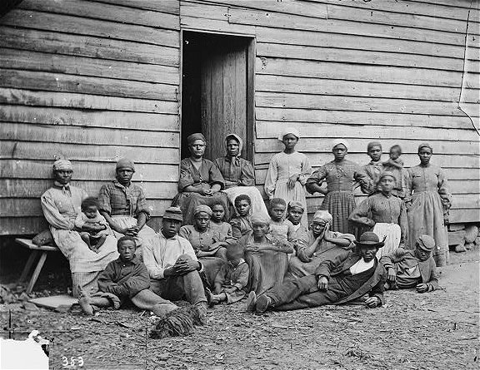
1862: Antietam and Emancipation

Slide 2
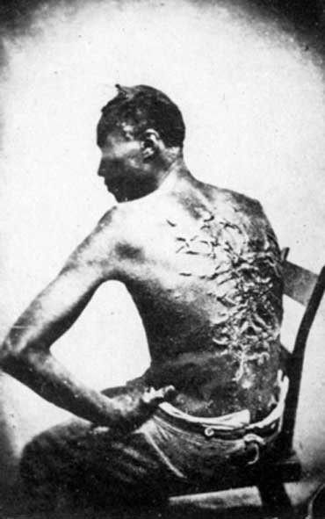
Antietam & Emancipation
Emancipation – The act of freeing
https://www.youtube.com/watch?v=SUVkXthLz4w

Slide 3
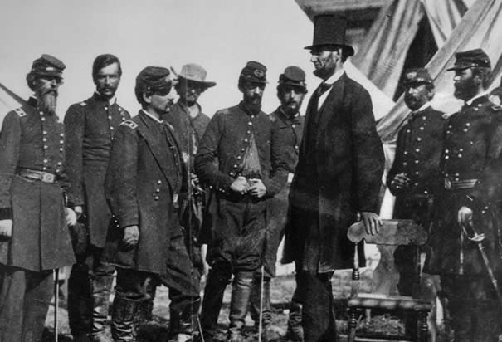
The War So Far
The war had not been going well for the Union armies.
The Union had lost every major battle it had fought in 1861 and 1862.
Notes:
The war had not been going well for the Union armies around Washington, D.C. The Union had lost every major battle in which it had fought in 1861 and 1862.

Slide 4
The War so Far
Reasons a Victory was Needed:
Lincoln wanted to show that his government was strong and could support or “back up” the proclamation.
Lincoln didn’t want it to appear that his government was weak, and that he was asking the slaves to rebel. against their masters.
Notes:
Before freeing the slaves could be added to the war aims Lincoln felt strongly that the Union needed a victory.

Slide 5
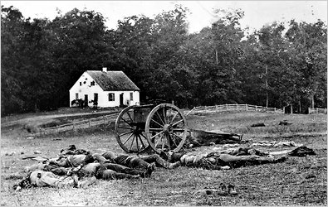
Antietam September 17, 1862
As a group read the Battle of Antietam Summary.

Slide 6
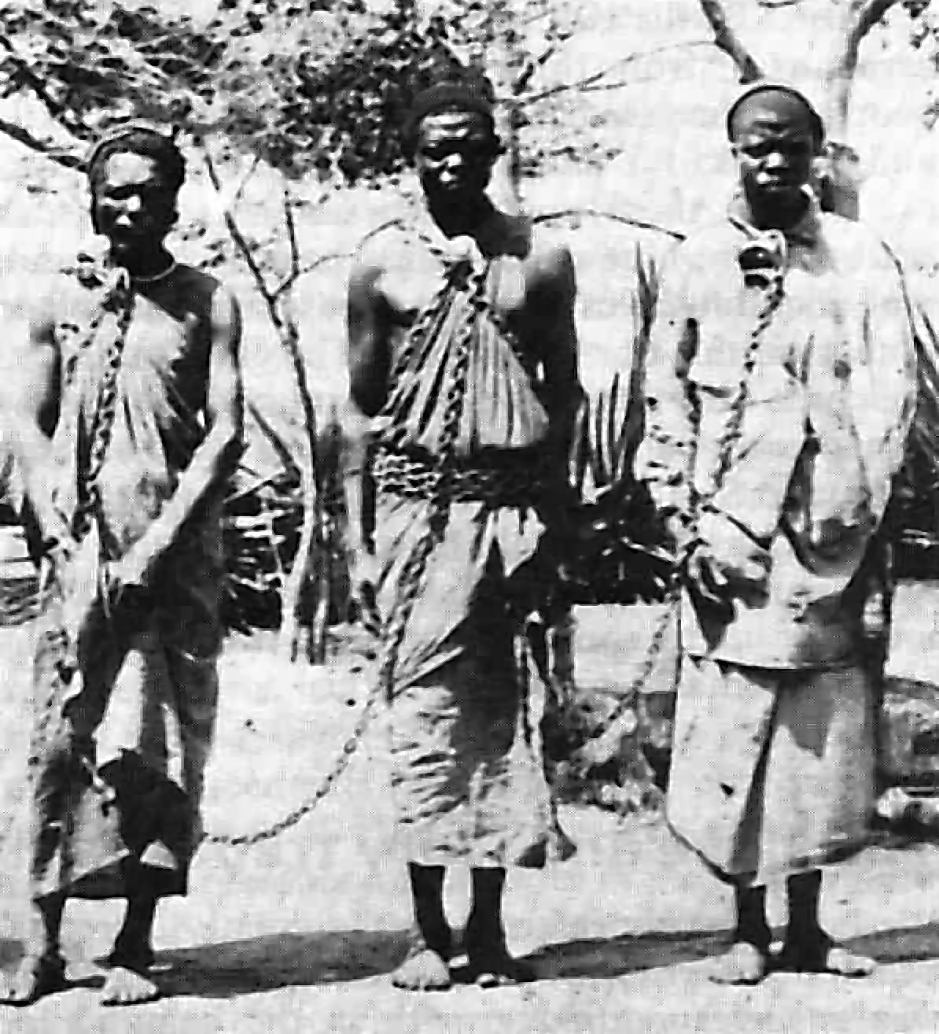
Emancipation
Abraham Lincoln now had a victory to issue the Emancipation Proclamation.
Notes:
Abraham Lincoln now had a victory to issue the Emancipation Proclamation.

Slide 7
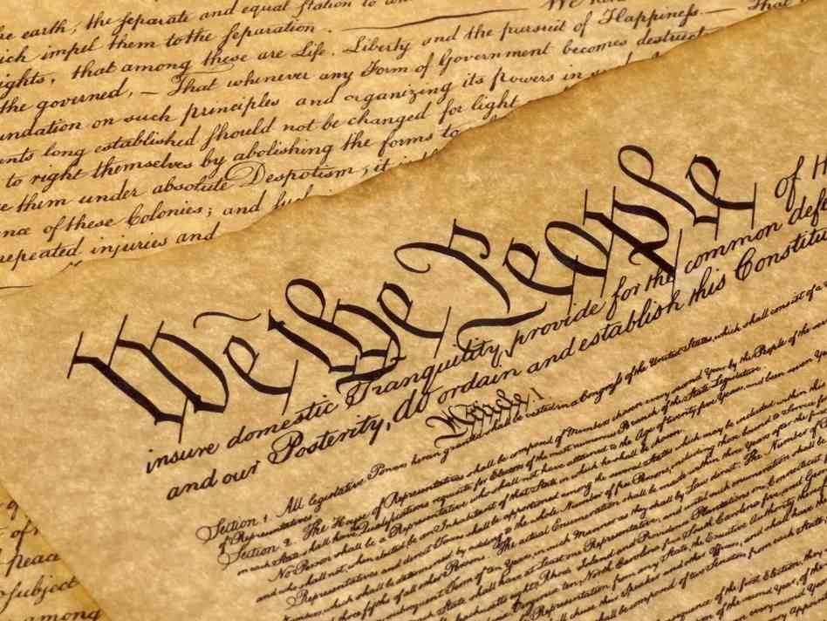
Emancipation Challenges
His first challenge was that the U.S. Constitution did not prohibit slavery.
Individual states could outlaw slavery, but not the U.S. Government..

Slide 8
Emancipation
Lincoln used his background as a lawyer to come up with a solution.

Slide 9
Emancipation
Question:
How did slave owners legally consider their slaves?

Slide 10
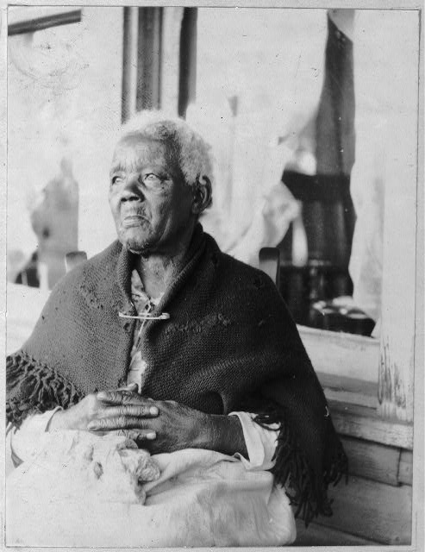
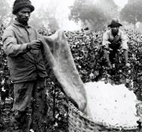
Emancipation
Answer:
Slaves were considered to be property.

Slide 11
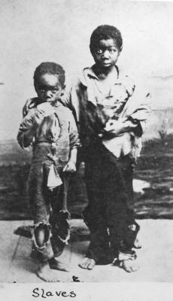
Emancipation
Question:
What happens to property that armies capture from their enemy during a war?
Image courtesy Library of Congress

Slide 12
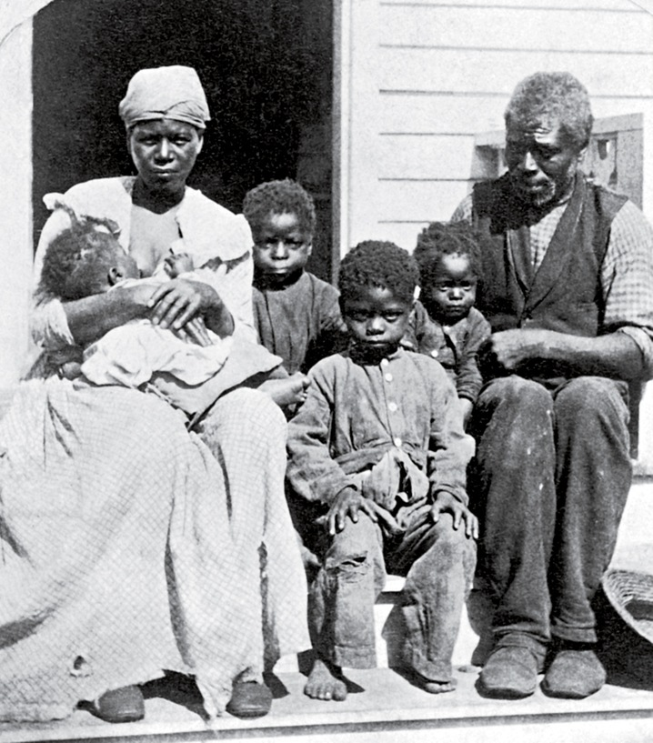
Emancipation
Answer:
The property captured (called contraband) belongs to the army that captured it and its government.

Slide 13
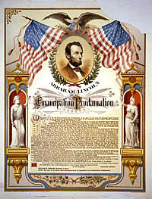
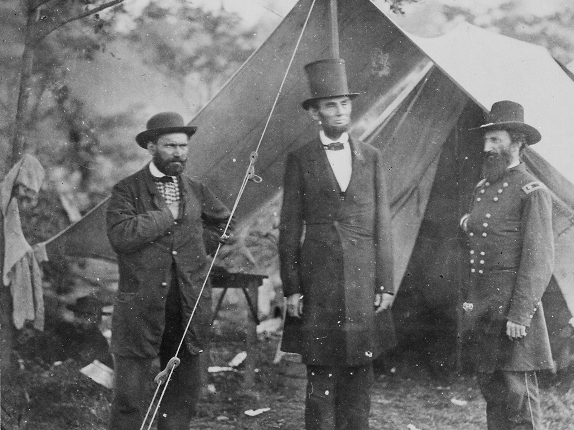
Emancipation
Lincoln therefore stated in his Emancipation Proclamation that any property (slaves) captured by U.S. military forces would be freed.
Notes:
Lincoln therefore stated in his Emancipation Proclamation that any property (slaves) captured by U.S. military forces would be freed.

Slide 14
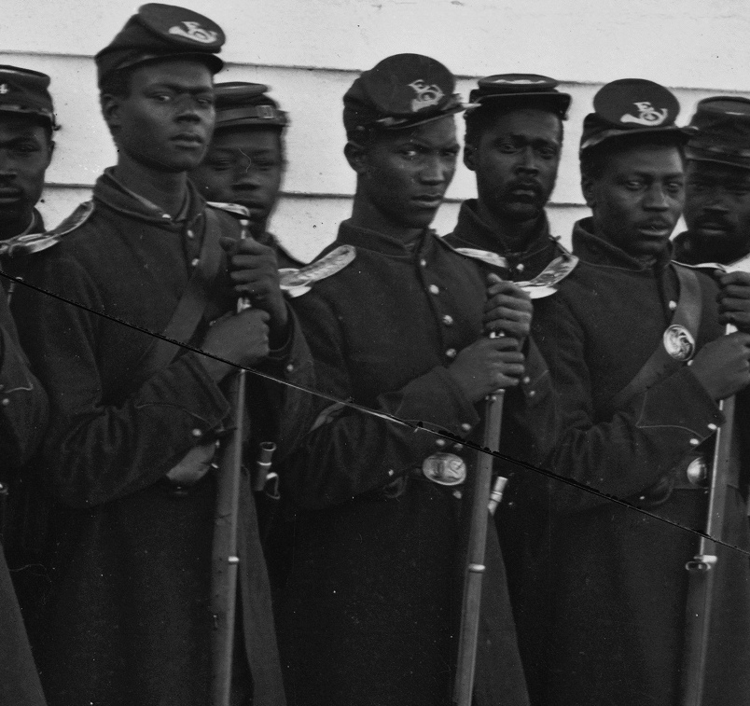
Emancipation
The war was no longer just about preserving the union, it was also about freeing the slaves.

Slide 15
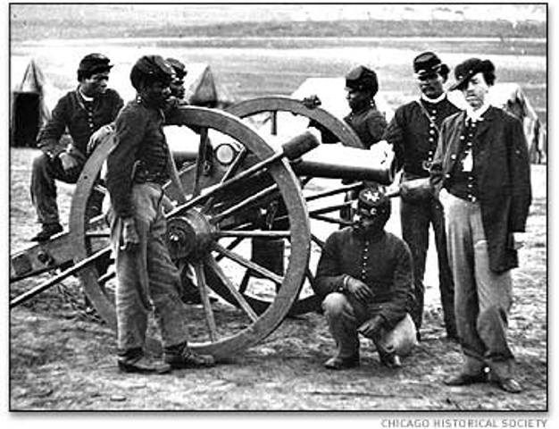
United States Colored Troops
Lincoln wanted African American men interested in joining the United States military to be able to do so.
However, some white, Union soldiers did not want to serve with African American soldiers.
Also concerns about how African Americans would fight since most of them did not have any military service training.
War Department placed blacks in all African American units commanded by white officers.
Notes:
Lincoln had some other challenges. He wanted African American men interested in joining the United States military to be able to do so. However, some white, Union soldiers did not want to serve with African American soldiers. There were also concerns about how well African Americans would fight since most of them did not have any military service.

Slide 16
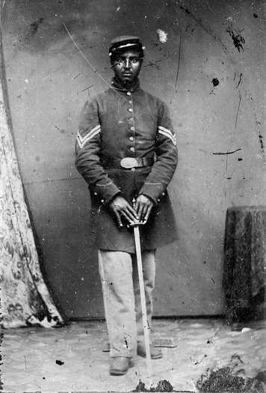
United States Colored Troops
Question:
What do you think were some advantages for the United States in having African Americans serve in the military?

Slide 17
United States Colored Troops
Answer:
African Americans joined the United States military in large numbers. Which led to a larger army, one of the deciding factors in the United States defeating the Confederacy.

Slide 18
Key items to remember from today’s lesson
The “bloodiest” day in American history was the Battle of Antietam, Maryland.
The Union “victory” at Antietam allowed President Lincoln to issue the Emancipation Proclamation.
Great Britain and France remained neutral and did not enter the war on the side of the Confederacy.
The Emancipation Proclamation freed slaves in the Confederate States (Eventually all states would free their slaves)
With African Americans joining the armed forces, the United States had a greater advantage over the Confederate States because of its number of soldiers and sailors.

