Slide 1
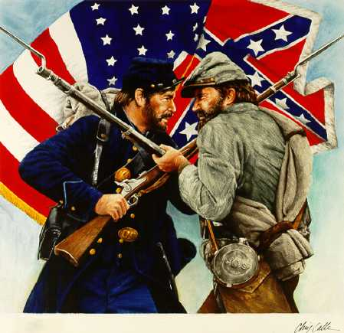
The Civil War
Explore the Civil War

Slide 2
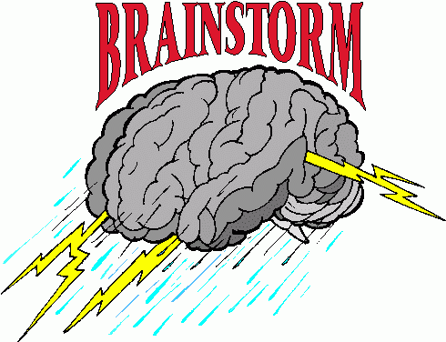
What Causes War?
Brainstorm at least 8 ideas as possible with group members
List on poster
In color

Slide 3
Overview
Deadliest war fought in the Western Hemisphere
Lasted from 1861-1865
Tore the country in half
North vs. South (Union vs. Confederacy)
The North eventually won
620,000 dead
4 million freed
The Civil War--History Channel Video

Slide 4
Discussion Questions
What was it?
What caused it?
Who fought it and why?
Was it costly?
How was the country changed as a result of the war?

Slide 5
White Southerners
The Antebellum Period
The Period of Southern history before the Civil War is often referred to as the “antebellum” (Latin for “before the war”). Some people have a romantic view of this time; Margaret Mitchell’s 1936 novel Gone With the Wind depicted the grand plantations and an elegant lifestyle of the south.
It was a time of great prosperity for the large plantation owners, who grew rich from cotton, tobacco, and sugar cane. But their society was plagued with slavery– a cause of growing tension with the North.
Government
After gaining independence from England, the U.S. worked to rebuild itself and create an identity for itself. The U.S. government was in its infancy and was more state-centralized at the time — individual state governments had more power than the federal government.
One of the major reasons that the South seceded from the union at the start of the Civil War was because it felt that the federal government was beginning to take too much power away from the states.

Slide 6
Steamboats & Plantations
Steamboats were an important means of transportation in the South. The first steamboat on the Mississippi was the New Orleans, built in 1811. Improved designs meant that the boats could travel in shallower water. By 1830, there were 200 steamboats on the Mississippi carrying passengers and cargo. They were driven by large paddle wheels. The fanciest boats had ornately decorated cabins, restaurants, and live music.
In the early 1800s, some Southern planters began growing sugar cane, initially brought to America by Spanish explorers. It was a profitable crop, but required large amounts of land and heavy investment in machinery and slaves. Sugar plantations were big in Louisiana. Sugar Cane was crushed and refined to make molasses, rum, and fuel.
Following Eli Whitney’s invention in 1793 of the cotton gin—a machine that separated cotton fiber from the seeds pods—cotton became the main cash crop in the South. Before it required a total of 100 man hours to separate cotton seed away from raw cotton fibers. The Cotton Gin automated the separation process. The machine could generate up to fifty pounds of cleaned cotton.
The plantation were worked by slaves, who did all the hard labor of picking. The backbreaking work and poor living conditions left them vulnerable to many diseases. They were constantly threatened with violent punishments or sale to another plantation. By 1850, the cotton industry had become vital to the economy of the South. Its importance was summed up in 1858 by senator James H. Hammond, who declared: “Cotton is king.”

Slide 7
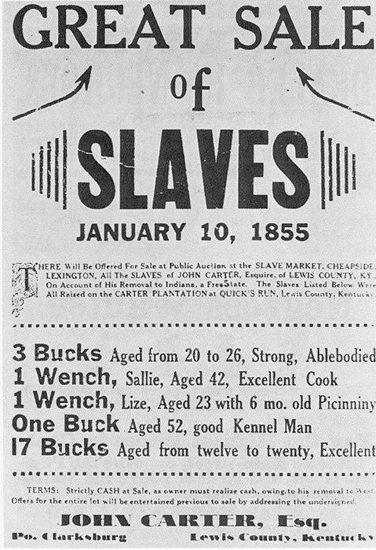
Slave Markets
Slaves were owned by many early Americans, particularly plantation owners in the South, who needed lots of workers to provide labor. Although Abolitionists—people who opposed slavery—helped pass laws during the 1800s to restrict slavery, by 1860 there were about four million slaves in the South. Slaves were considered property and were often separated from their families and forced to work under harsh conditions. Many tried to run away, and some succeeded, using a secret network of routes called the Underground Railroad
Most slave families in the United States originally came from Africa. They were brought by ships, in which they were forced to live below deck in crowded, filthy conditions. Many died on the journey. When they arrived, they were sold at markets or at auctions to the highest bidders. The children of slaves were sold in the same way and it was common for families to be split up. Potential owners would choose slaves just as they would choose new animals, looking at their muscles, teeth, and other physical attributes to make sure they were strong and would make good workers.

Slide 8
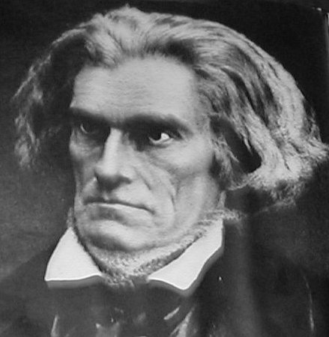
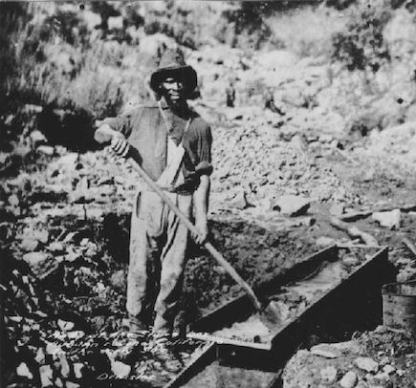
Defending Slavery
Some influential southern politicians passionately fought for slavery. Politician John C. Calhoun (vice pres. 1825-32) argued that slavery was a “positive good” rather than a necessary evil. In a speech he made in 1837, he said that whites were naturally the dominant race and deserved to have slaves, and also that American slaves were treated better than slaves in other countries.

Slide 9
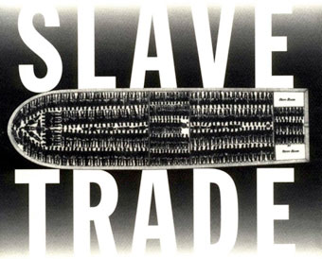

Slide 10
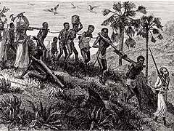
The Middle Passage
The Middle Passage= The sea journey undertaken by slave ships from West Africa to the Americas
For weeks, months, sometimes as long as a year, Africans waited in the dungeons of the slave factories
along Africa's western coast.
Made a long, difficult journey from Africa's interior
out of the roughly 20 million who were taken from their homes and sold into slavery, half didn't complete the journey to the African coast,
most of those dying along the way

Slide 11
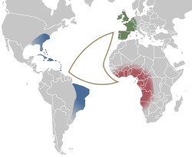
Slave Trade
The captives were about to embark on the infamous Middle Passage
Called Middle Passage because middle leg of a three-part voyage
Began and ended in Europe
The first leg of the voyage: carried cargo that included iron, cloth, brandy, firearms, and gunpowder.
After landing on Africa's slave coast, the cargo was exchanged for Africans. Fully loaded with its human cargo, the ship set sail for the Americas,
In America, slaves were exchanged for sugar, tobacco, or some other product. The final leg brought the ship back to Europe.

Slide 12
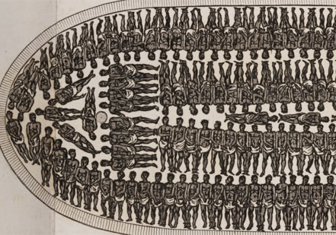
Slave Trade
Africans did not return to their homeland
Simply disappeared
More than a few thought that the Europeans were cannibals.
Olaudah Equiano, an African captured as a boy who later wrote an autobiography, recalled . . .
“When I looked round the ship too and saw a large furnace of copper boiling, and a multitude of black people of every description chained together, every one of their countenances expressing dejection and sorrow, I no longer doubted of my fate and quite overpowered with horror and anguish, I fell motionless on the deck and fainted. . . . I asked if we were not to be eaten by those white men with horrible looks, red faces and long hair?”

Slide 13
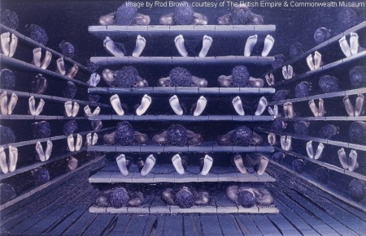
On the Ships…
The slaves were branded with hot irons and restrained with shackles.
Their "living quarters" was often a deck on the lower portion of the ship
had less than five feet of headroom
300 to 400 people packed in a tiny area: little ventilation –not even enough space to place buckets for human waste
disease spread.
According to Equiano:
"The closeness of the place, and the heat of the climate, added to the number in the ship, which was so crowded that each had scarcely room to turn himself, almost suffocated us. This produced copious perspirations, so that the air soon became unfit for respiration, from a variety of loathsome smells, and brought on a sickness among the slaves, of which many died."

Slide 14
Faced with the nightmarish conditions of the voyage and the unknown future that lay beyond, many Africans preferred to die. But even the choice of suicide was taken away from these persons. From the captain's point of view, his human cargo was extremely valuable and had to be kept alive and, if possible, uninjured. A slave who tried to starve him or herself was tortured. If torture didn't work, the slave was force fed with the help of a contraption called a speculum orum, which held the mouth open. Despite the captain's desire to keep as many slaves as possible alive, Middle Passage mortality rates were high. Although it's difficult to determine how many Africans died in route to the new world, it is now believed that between ten and twenty percent of those transported lost their lives.

Slide 15
Helped by “Moses”
Harriet “Moses” Tubman was born a slave in Maryland.
1849; escaped to Philadelphia, Pennsylvania (free state)
It was a crime to help runaway slaves (Fugitive Slave Law 1850)
Made 19 rescue trips
Helped more than 300 slaves to freedom using the underground railroad

Slide 16
Underground Railroad
What was it?
A vast network of people who helped fugitive slaves escape to the North and to Canada
Who ran it?
It was not run by any single organization or person. Rather, it consisted of many individuals -- many whites but predominantly blacks.
According to one estimate, the South lost 100,000 slaves between 1810 and 1850
Homes and businesses where fugitives would rest and eat were called "stations" and "depots" and were run by "stationmasters"
Those who contributed money or goods were "stockholders," and the "conductor" was responsible for moving fugitives from one station to the next.
.
The first step was to escape from the slaveholder.
Sometimes a "conductor," posing as a slave, would enter a plantation and then guide the runaways northward.
The fugitives would move at night.
They would generally travel between 10 and 20 miles to the next station, where they would rest and eat, hiding in barns and other out-of-the-way places.
While they waited, a message would be sent to the next station to alert its stationmaster.
Fugitives would also travel by train and boat
Money was needed for transportation and to improve the appearance of the runaways -- a black man, woman, or child in tattered clothes would invariably attract suspicious eyes—money was donated by individuals and also raised by various groups.
Bounty hunters were paid for capturing runaway slaves (often chased with bloodhounds)

Slide 17
Causes of Division

Slide 18
Missouri Compromise: (1820)
Missouri wanted to join the Union as a slave state.
After two years of debate, the Missouri Compromise was agreed upon.
admitted Missouri to the Union as a slave state and
admitted Maine as a free state to
maintain the balance in the Senate.
prohibited slavery north of latitude 36° 30’,with the exception of Missouri, and allowed it south of that line.

Slide 19
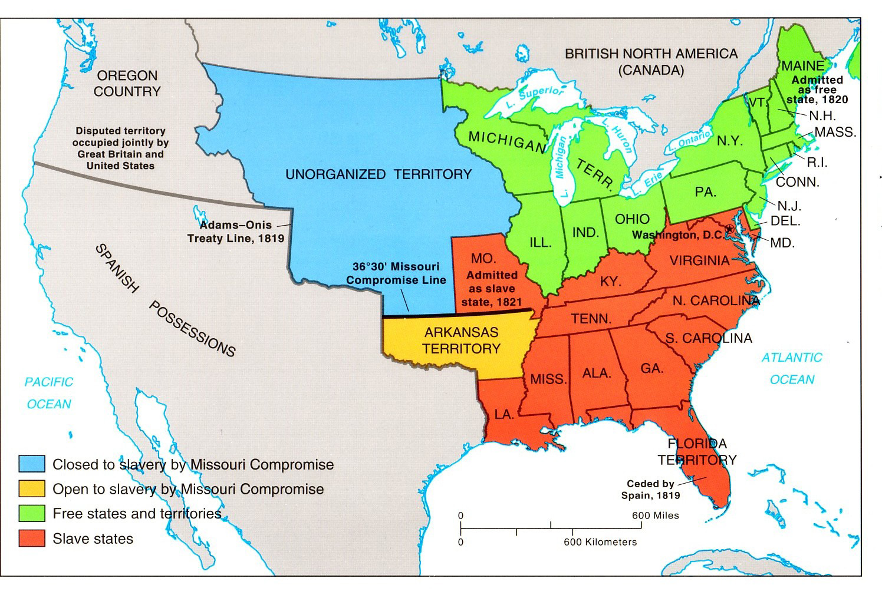
Missouri Compromise

Slide 20
Nat Turner’s Rebellion (1831)
Nat Turner, a slave, along with about 60 other slaves led a violent rebellion.
Result: 50 Virginians dead
Turner and many others were executed
Nat Turner’s Rebellion struck long-term fear in the hearts of slave owners.
Result: caused them to place new restrictions on slaves
prompted a national debate on the slavery question.

Slide 21
Compromise of 1850
Disagreements erupted over whether land acquired from Mexico would become slave or free states.
The compromise admitted California as a free state.
New Mexico, Nevada, Arizona, and Utah were allowed to decide whether or not to permit slavery in their territories when they applied for statehood.
The compromise included the Fugitive Slave Act
denied captured blacks legal power to prove their freedom
required U.S. marshals and deputies to help slave owners capture their property.
The compromise also ended the slave trade in the District of Columbia.

Slide 22
Harriet Beecher Stowe’s Uncle Tom’s Cabin (1852)
Book published in response to the Fugitive Slave Act of 1850
sold two million copies worldwide within two years
After the Bible, Uncle Tom’s Cabin was the highest selling book of the 19th century.
Caused people to understand the horrors of slavery
Caused Northerners to protest the Fugitive Slave Act
President Lincoln read Uncle Tom’s Cabin before announcing the Emancipation Proclamation in 1862,
“So this is the little woman who started this great war!”
-Abraham Lincoln

Slide 23
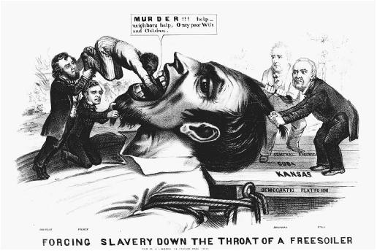
Kansas-Nebraska Act (1854)
This act repealed the Missouri Compromise
Allowed settlers in the territories of Kansas and Nebraska to decide whether they would allow slavery when they applied for statehood.
The Kansas-Nebraska Act split the Democratic Party
destroyed the Whig Party; they helped form the Republican Party.

Slide 24
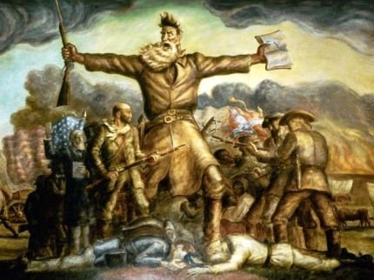
“Bleeding Kansas” (1856)
Disagreements over whether slavery should be allowed in Kansas
led to violence among settlers.
Kansas eventually entered as a free state

Slide 25
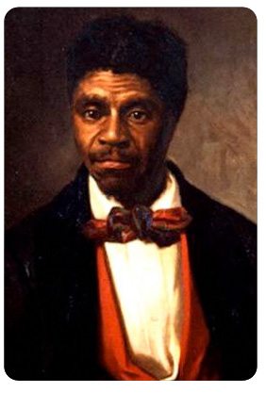
Dred Scott Decision (1857)
Dred Scott, a slave, sued for his freedom.
Grounds:
master had taken him to live in free territories
believed he should be set free.
Case went to the Supreme Court
stated that no slave or descendant of a slave could be a U.S. citizen.
As a non-citizen, Scott was not entitled to file suit.
The Court also ruled that Congress had no power to exclude slavery from the territories; Missouri Compromise was unconstitutional.

Slide 26
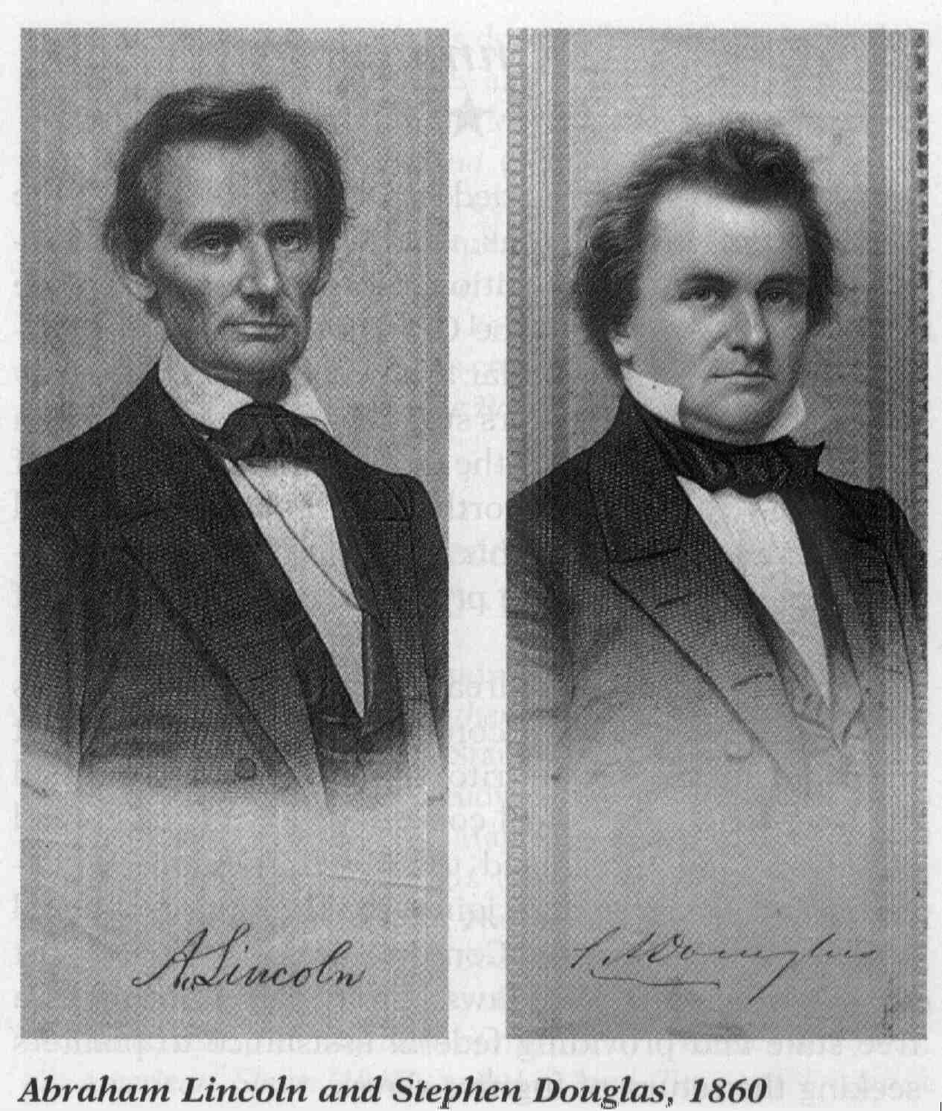
Lincoln-Douglas Debates (1858)
Debates between Abraham Lincoln and Stephen Douglas sponsor of the Kansas-Nebraska Act
Campaign to win the Senate seat in Illinois
7 debates—tackled the issue of survival of the union and the issue of slavery.
The debates made Lincoln a prominent national figure

Slide 27
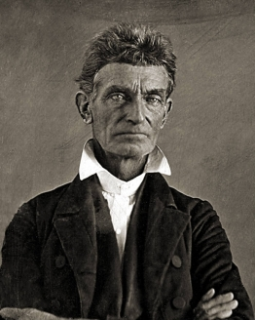
John Brown’s Raid (1859)
John Brown and 22 other men raided the town of Harpers Ferry, Virginia, hoping to arm and free slaves.
Brown and his raiders captured many of the town’s most important citizens and held them hostage.
Within 24 hours, Brown was captured and convicted of treason, murder, and conspiracy to incite slave rebellion. He was hanged that December.
Seen as a martyr in the North and instilled terror and fear in the South

Slide 28
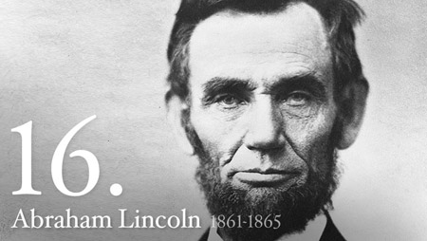
THE FINAL STRAW
Republican Abraham Lincoln won the 1860 presidential race
Southerners became very fearful that the anti-slavery Republicans would try to change their way of life.

Slide 29
Excerpt, Civilian And Gazette Weekly November 13, 1860, Galveston, Texas
The Governor [of South Carolina], “earnestly recommended that, in the event of Abraham Lincoln’s election to the Presidency, a convention for the people of this State be immediately called to consider and determine for themselves the mode and measure of redress.” [The Governor stated the following] "That the only alternative left, in my judgment, is the secession of South Carolina from the Federal Union. The indications of many of the Southern States justify the conclusion that the secession of South Carolina would be immediately followed, if not adopted simultaneously, by them, and ultimately by the entire South…. The State has, with great unanimity, declared that she has the right peaceably to succeed, and no power on earth can rightfully prevent it.”

Slide 30
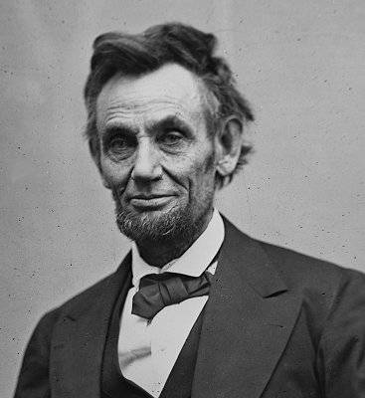
Excerpt, First Inaugural Address Abraham Lincoln, President of the United States of America
In your hands, my dissatisfied fellow-countrymen, and not in mine, is the momentous issue of civil war. The Government will not assail you. You can have no conflict without being yourselves the aggressors. You have no oath registered in heaven to destroy the Government, while I shall have the most solemn one to ‘preserve, protect, and defend it.’

Slide 31
Secession of South Carolina December 20, 1860
South Carolina formally seceded from the Union.
Cause: felt Abraham Lincoln, would violate state’s rights.
Over the next 6 weeks:
6 other states secede.
The Confederate States of America was established.

Slide 32
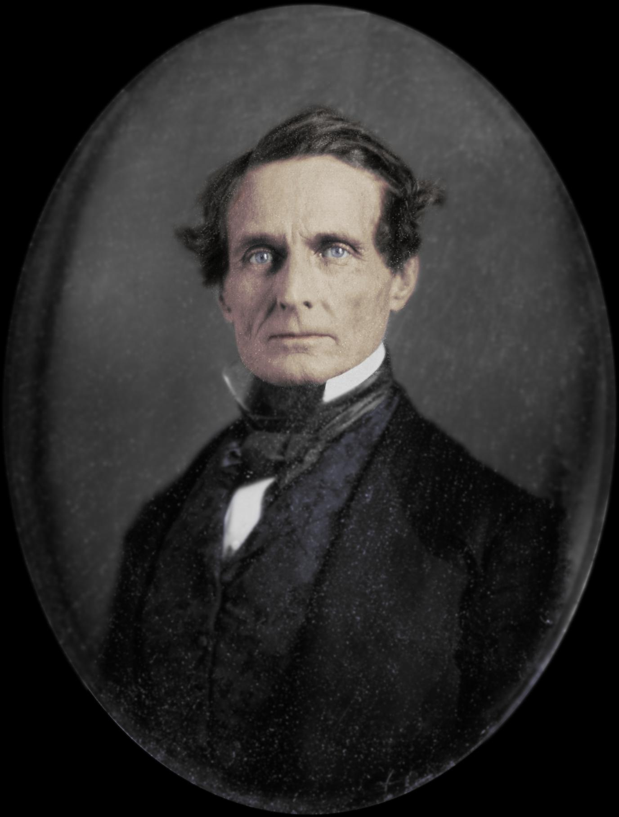
A President for the Confederacy February 9, 1861
Jefferson Davis
Mississippi Senator
chosen as the President of the Confederate States of America.

Slide 33
GAME ON!!! Attack on Fort Sumter—April 12 & 13 1861
Located off the coast of South Carolina
Confederate forces fired on the fort
The United States/Union surrendered Fort Sumter
Attack on Fort Sumter was the opening engagement of the American Civil War.

Slide 34
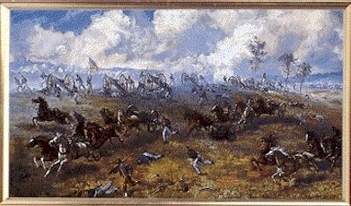
The Confederacy has the Upper Hand
Confederacy won some major victories
First Manassas (aka Bull Run) July 21, 1861– in Virginia
Not far from Washington D.C.
The first major land battle of the Civil War
The battle was marked by confusion, with Union and Confederate troops wearing similar uniforms and flying similar flags.
4,700 deaths
Confederacy won this battle

Slide 35
Battle of Antietam
Battle of Gettysburg
a.k.a. Battle of Sharpsburg
bloodiest day of the American Civil War
bloodiest single day in all of American history
Fought primarily on September 17, 1862, between the town of Sharpsburg, Maryland, and Antietam Creek
Casualties= 22,720
Union Victory
Gettysburg, Pennsylvania (July 1–July 3, 1863)
largest battle of the American Civil War
largest battle ever fought in North America (around 85,000 men in the Union’s Army and 75,000 in the Confederacy’s Army)
Casualties at Gettysburg totaled 23,049 for the Union (3,155 dead, 14,529 wounded, 5,365 missing).
Confederate casualties were 28,063 (3,903 dead, 18,735 injured, and 5,425 missing), more than a third of Lee’s army.
Major Union Victory

Slide 36
Robert E Lee
Stonewall Jackson

Slide 37
Ulysses S Grant
William Tecumseh Sherman

Slide 38
Life During the Civil War

Slide 39
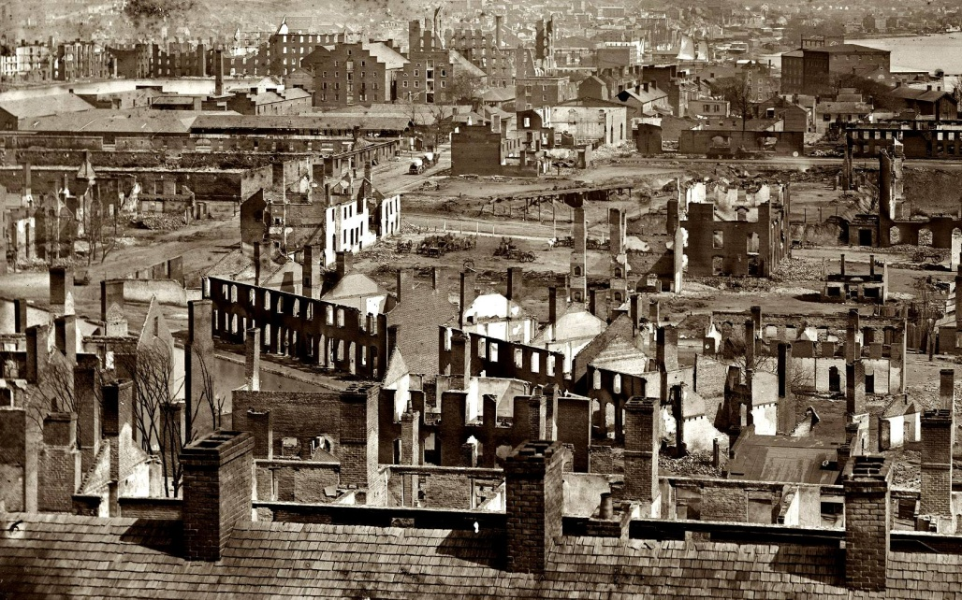
Hardships of the South
Life in the South changed most dramatically
Armies spent most of their time in the South
The South suffered a lot of destruction
Farmers lost their crops and homes
Many Southern civilians became refugees
Many towns faced shortages
Food
Household items

Slide 40
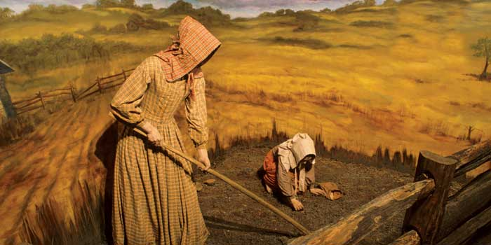
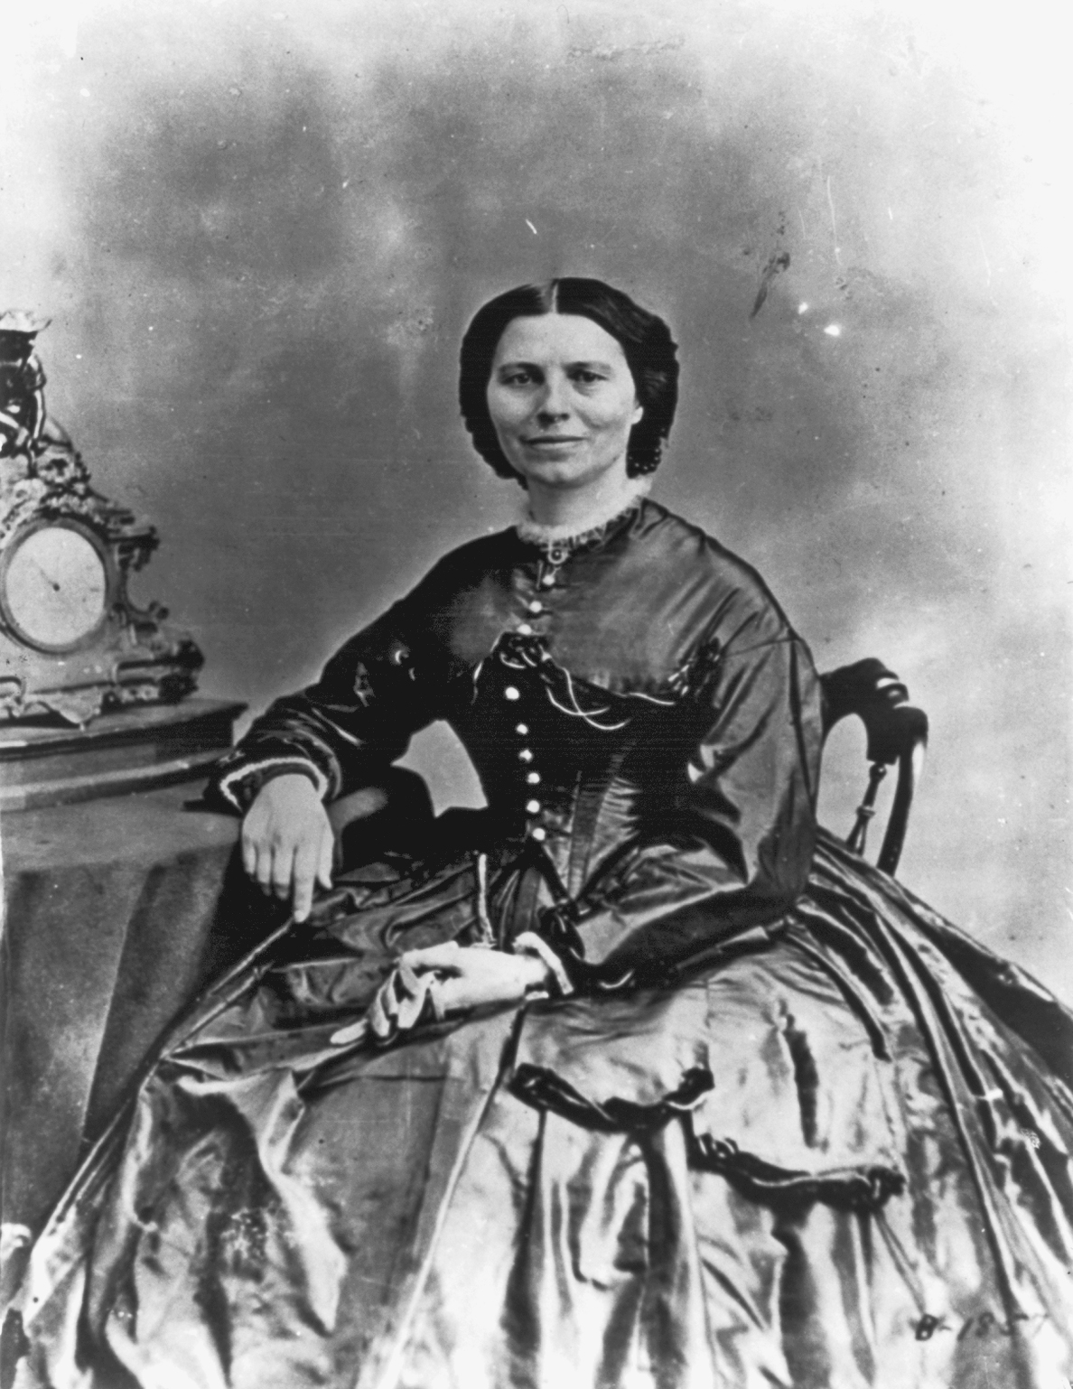
New Roles for Women
Women kept the economy going
Ran farms and factories
Taught school
Ran offices
Kept government records
Nurses
Many doctors didn’t welcome them
Believed to be to delicate for wartime hospitals
Spying
Women served as spies to gather information about the enemy
Disguise
Dressed up as men and became soldiers

Slide 41
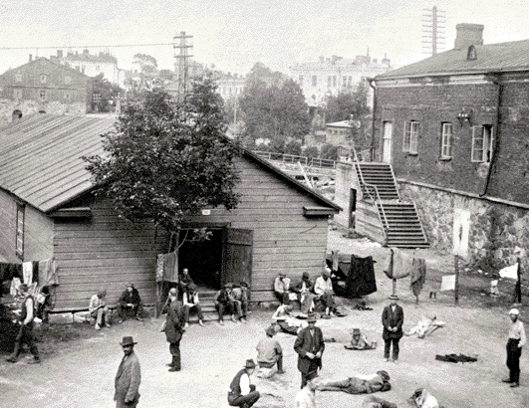
Prisoners of War
Each side had prison camps
Little or nothing to eat
Men slept in shallow holes dug in the ground
Andersonville Confederate Prison
Built to hold 10,000
By August 1864 it held 33,000

Slide 42
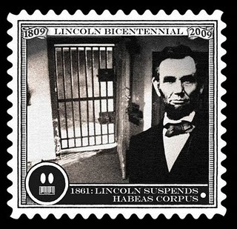
Jail Without Trial
Habeas Corpus was suspended by Lincoln & Davis during the war
Both sides were able to hold prisoners without putting them on trial

Slide 43
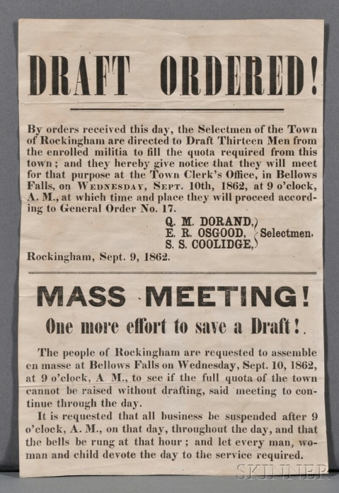
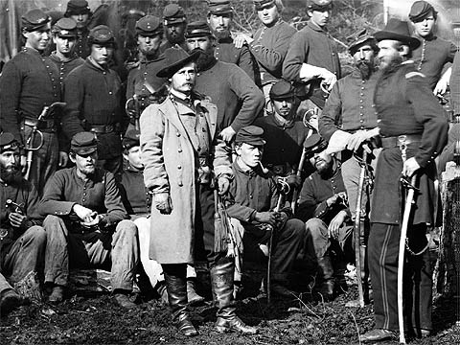
Draft Laws
Both sides faced difficulty getting troops to sign up.
Confederate Congress passed the Draft in 1862
Men between 18-35 were required to serve for 3 years
Later they altered the ages from 17-50
Exceptions
You could hire a substitute to serve in your place
A man with 20 or more slaves didn’t have to serve
North offered a bounty/sum of money to encourage men to join
Draft was passed in 1863
Men ages 20-45 had to register
Could hire a substitute or pay $300

Slide 44
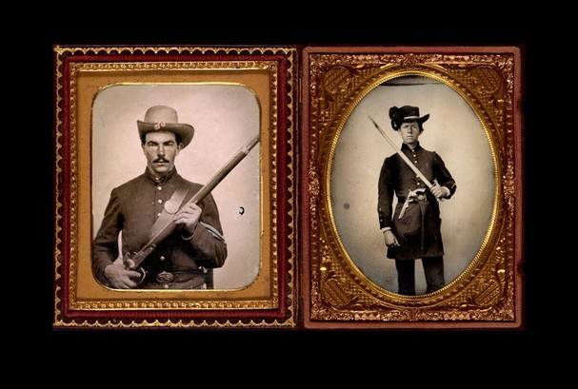
War & Economy
3 ways to pay for war:
Borrowed money
Passed new taxes
Printed money
Northern bills became known as greenbacks
The Northern economy made money off the war
Made guns, ammunition, shoes, and uniforms
Farmers sold their crops to feed the troops

