Slide 1
Life During the Civil War

Slide 2
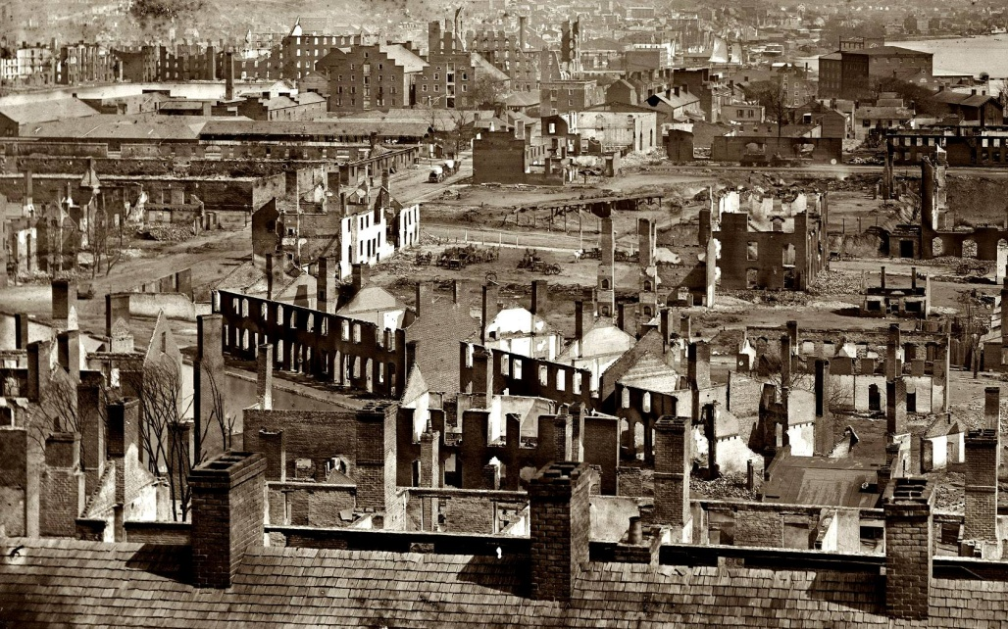
Hardships of the South
Life in the South changed most dramatically
Armies spent most of their time in the South
The South suffered a lot of destruction
Farmers lost their crops and homes
Many Southern civilians became refugees
Many towns faced shortages
Food
Household items

Slide 3
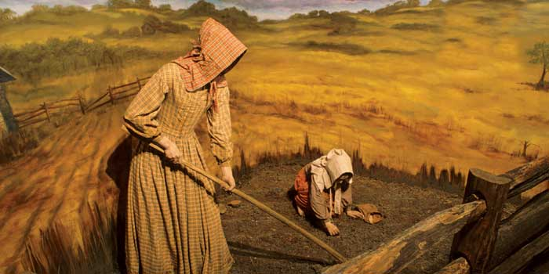
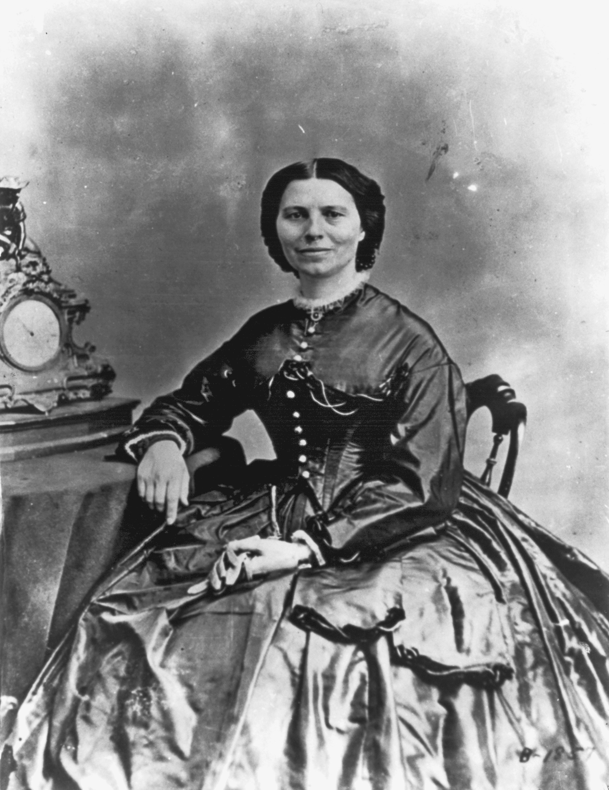
New Roles for Women
Women kept the economy going
Ran farms and factories
Taught school
Ran offices
Kept government records
Nurses
Many doctors didn’t welcome them
Believed to be to delicate for wartime hospitals
Spying
Women served as spies to gather information about the enemy
Disguise
Dressed up as men and became soldiers

Slide 4
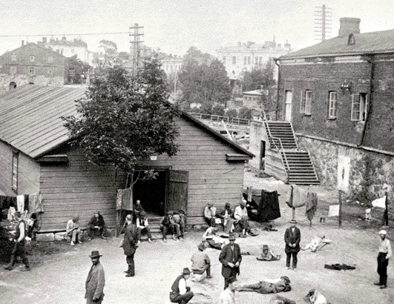
Prisoners of War
Each side had prison camps
Little or nothing to eat
Men slept in shallow holes dug in the ground
Andersonville Confederate Prison
Built to hold 10,000
By August 1864 it held 33,000

Slide 5
Jail Without Trial
Habeas Corpus was suspended by Lincoln & Davis during the war
Both sides were able to hold prisoners without putting them on trial

Slide 6
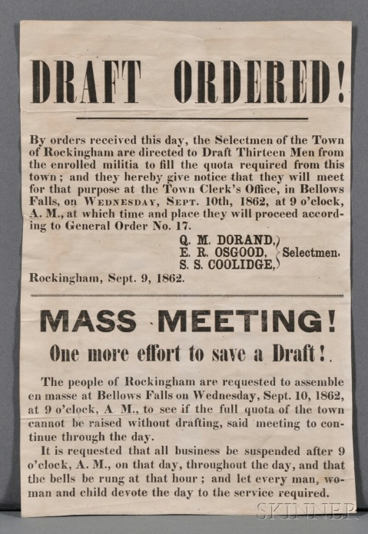
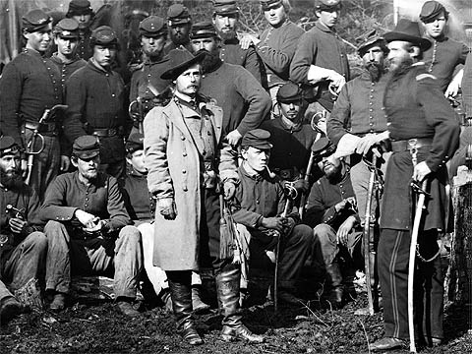
Draft Laws
Both sides faced difficulty getting troops to sign up.
Confederate Congress passed the Draft in 1862
Men between 18-35 were required to serve for 3 years
Later they altered the ages from 17-50
Exceptions
You could hire a substitute to serve in your place
A man with 20 or more slaves didn’t have to serve
North offered a bounty/sum of money to encourage men to join
Draft was passed in 1863
Men ages 20-45 had to register
Could hire a substitute or pay $300

Slide 7
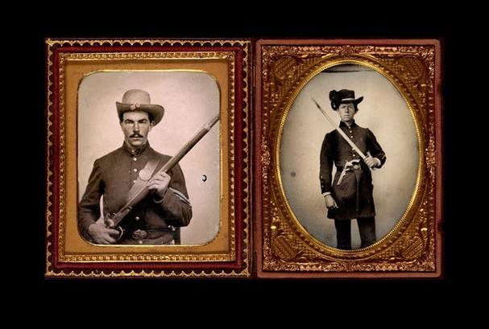
War & Economy
3 ways to pay for war:
Borrowed money
Passed new taxes
Printed money
Northern bills became known as greenbacks
The Northern economy made money off the war
Made guns, ammunition, shoes, and uniforms
Farmers sold their crops to feed the troops

