Slide 1
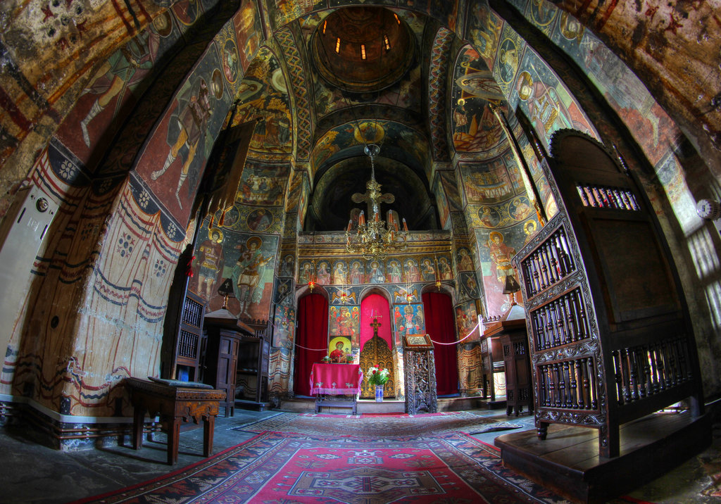
Ch. 14/Sec. 2
The Division of the Christian Church

Slide 2
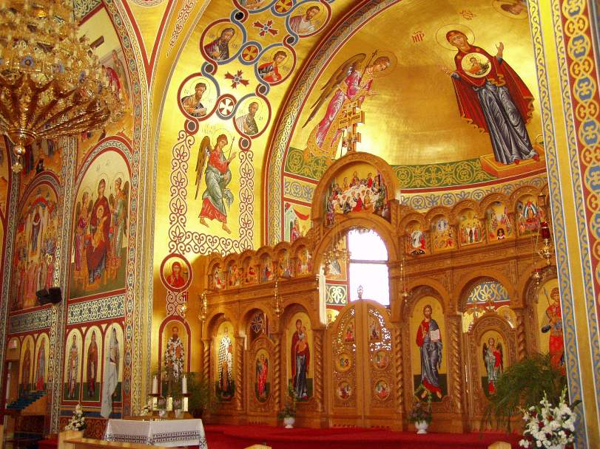
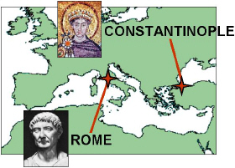
Religious Differences
Late 300s—Christianity official religion of the Roman empire
groups began to argue about beliefs/issues
Split into 2 churches: Roman Catholic & Eastern Orthodox

Slide 3
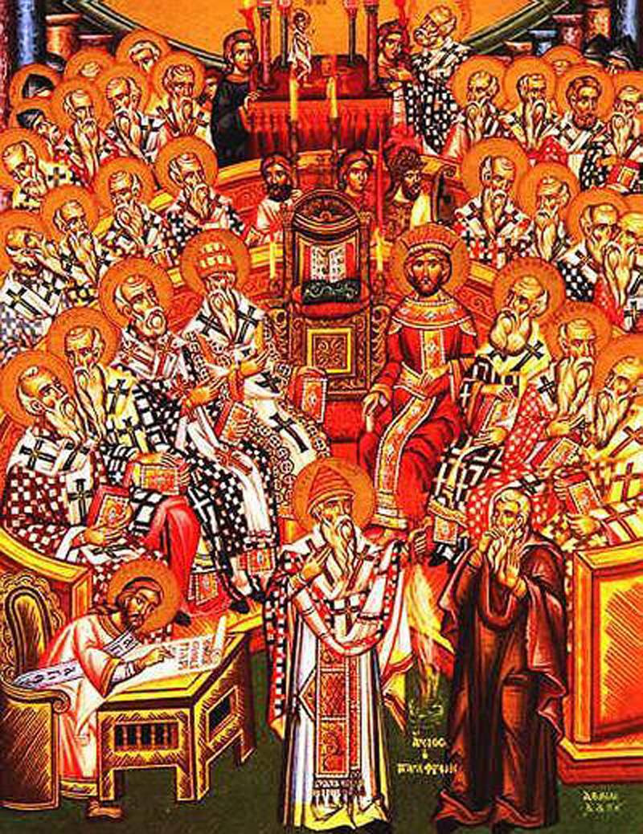
Nicene Creed
Disagreed over who exactly Jesus was– Fully human?? Fully divine?? Both??
Council of Bishops met in 325 in city of Nicea (City in present day Turkey)
Here they adopted a statement of beliefs/creed
Over time Eastern and Western Christians disagreed over the exact wording

Slide 4
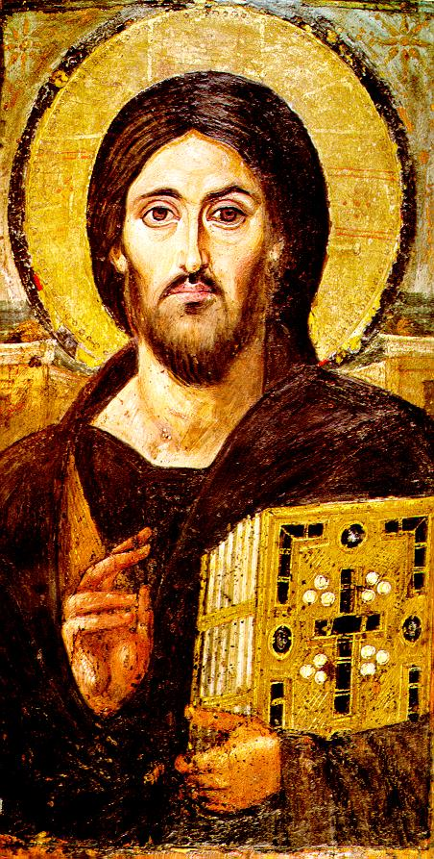
Icons
Icon—holy image
Honoring icon was seen as a pathway to God and teach people about God
To others it seemed like worshiping objects
Byzantine emperors tried to stop icon use (iconoclasts=image-breakers)
Iconoclasts went into churches and smashed icons
Led to violence between the groups

Slide 5
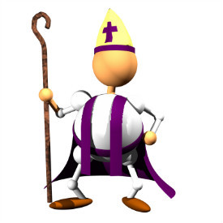
Church Organization
Christianity grew because of its strong organization
Bishops—were the most important leaders
At first each church was led by a bishop
Later, a single bishop was in charge of all the churches in a city
Eventually, bishops gained power over all the churches in a region
Bishops of the 5 most important cities were called patriarchs: Constantinople, Rome, Alexandria, Antioch, and Jerusalem

Slide 6
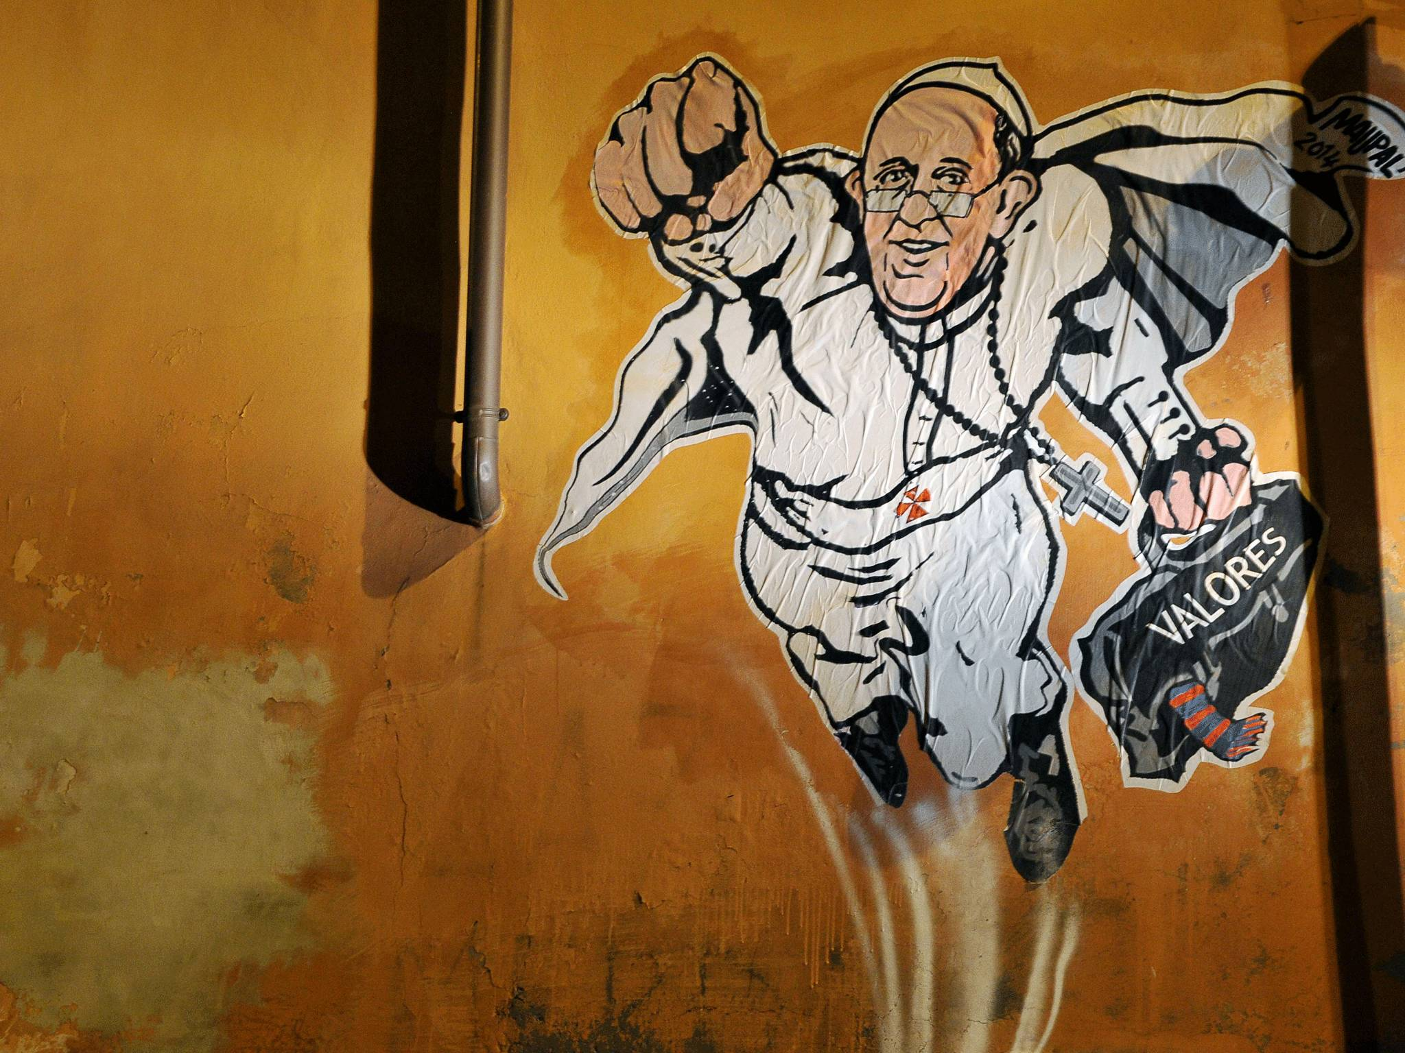
Power of the Pope
The 5 patriarchs were equal in authority
Over time the bishop of Rome claimed authority over Christians everywhere (Pope)
Believed they were Peter’s successor
Eastern patriarchs and the Byzantine emperors rejected this view of the Pope
Wanted to be in charge of the church in their empire

Slide 7
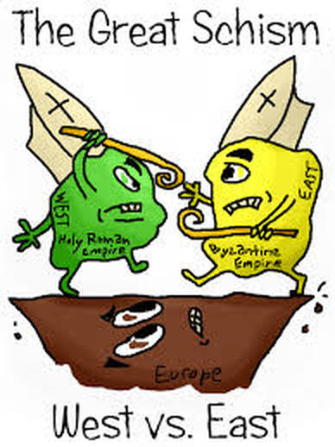
The Great Schism
In 1054, Eastern and Western churches split because of growing differences
Schism= split/division
Eastern branch= Eastern Orthodox Church
Orthodox means following establish beliefs
Byzantine emperor was head of the church
Head bishops handled daily affairs
Western branch= Roman Catholic Church
Roman because it was based in Rome
Catholic means universal
Pope is the head; didn’t take orders from the Byzantine emperor

Slide 8
Different Traditions
Roman Catholic Church | Eastern Orthodox Church
Pope headed the Church | Byzantine emperor headed the Church
Pope highest Church official | Patriarch of Constantinople was the highest Church official
Rituals and teachings were in Latin | Rituals and teachings were in Greek
Priests could not marry | Priests could marry
Greek Orthodox Church--they are each governed by a committee of Bishops, called the Holy Synod, with one central Bishop holding the honorary title of "first among equals.”
1.2 billion followers
23–24 million followers (about 50% of whom are in Greece)
http://www.bbc.com/news/world-21443313

Slide 9
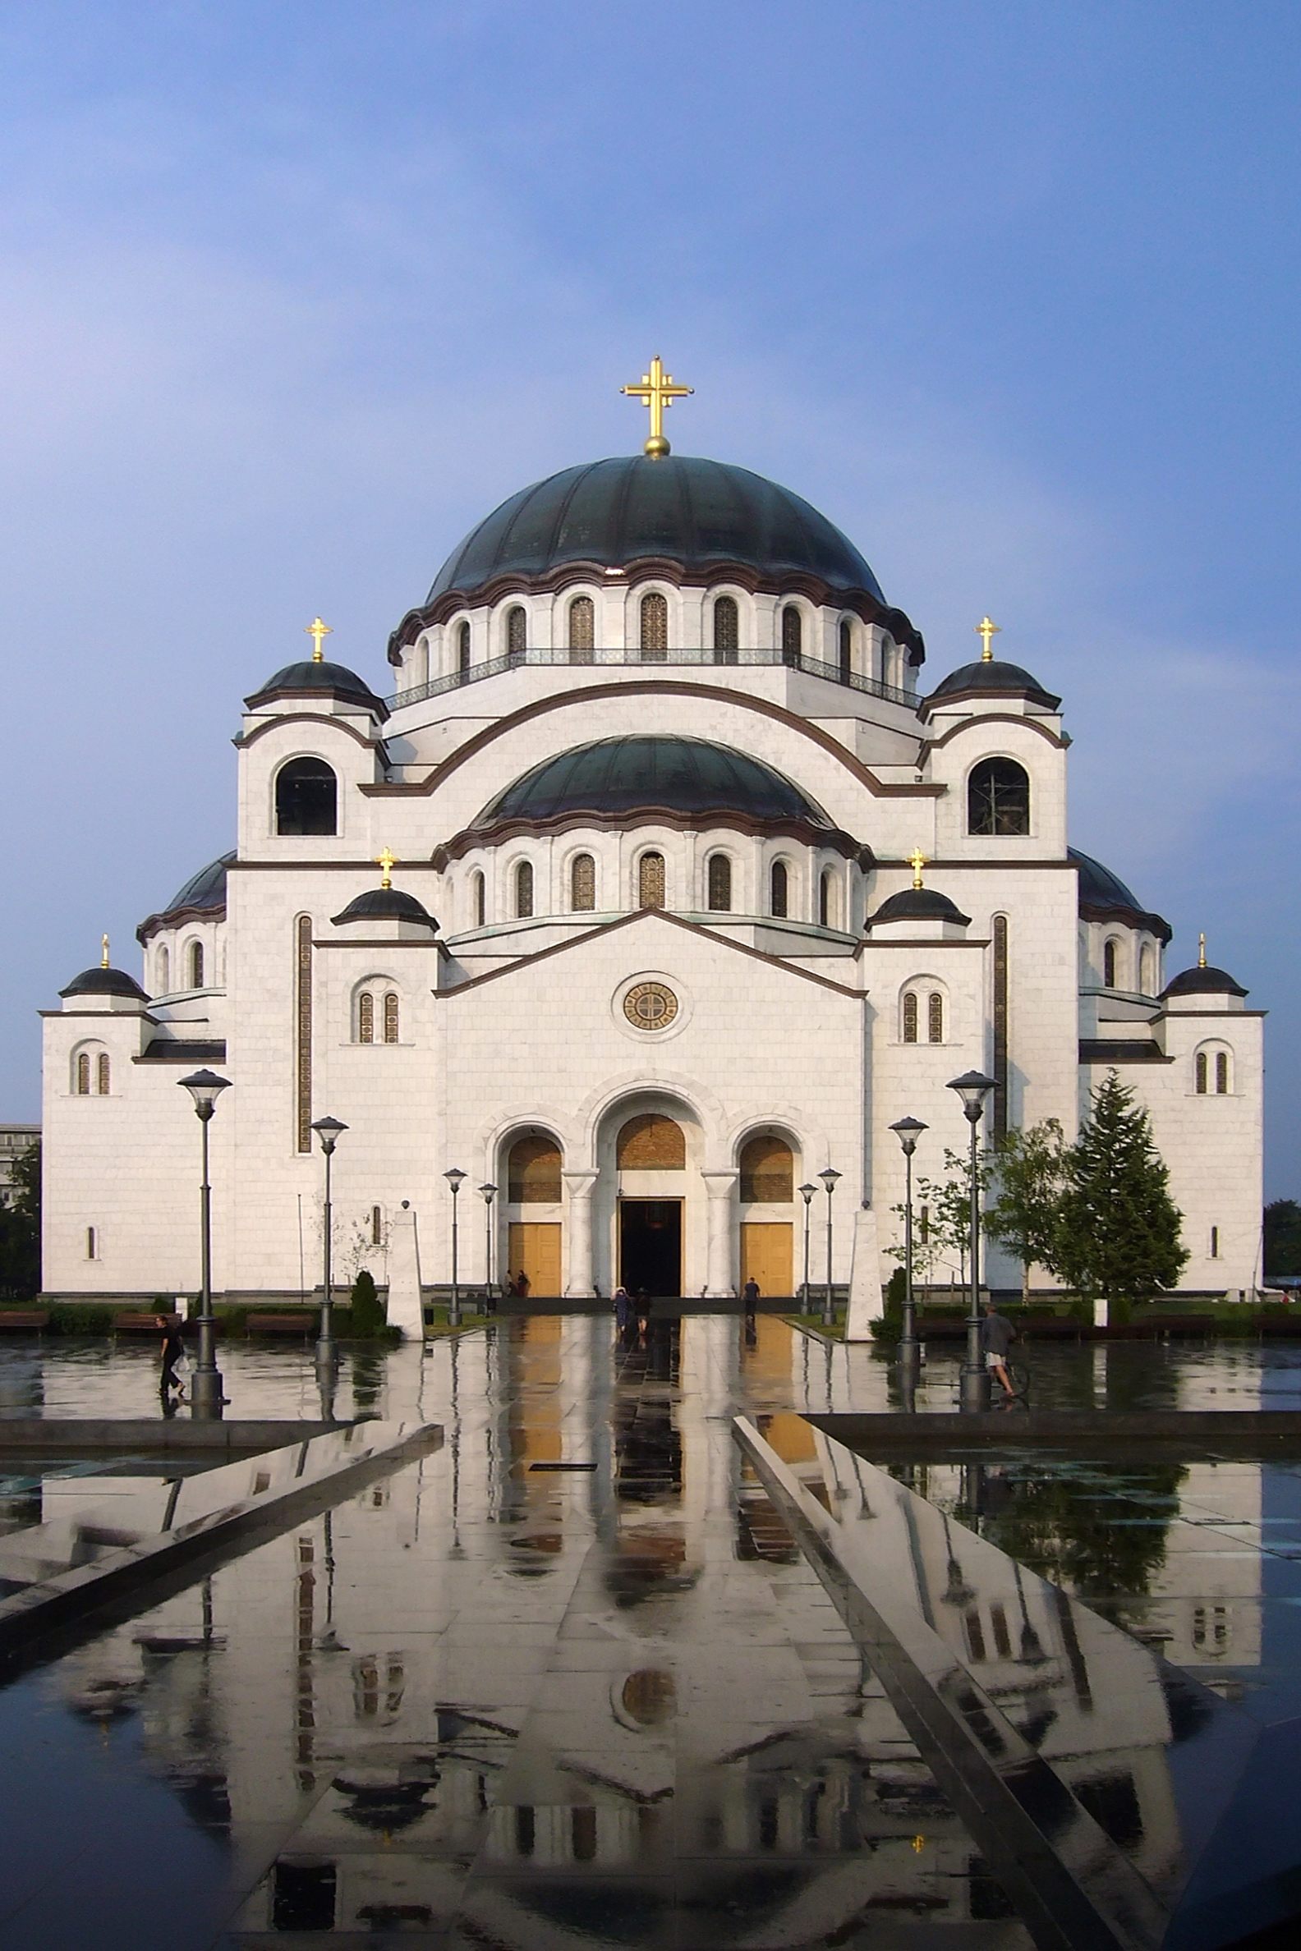
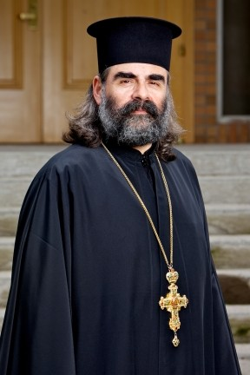
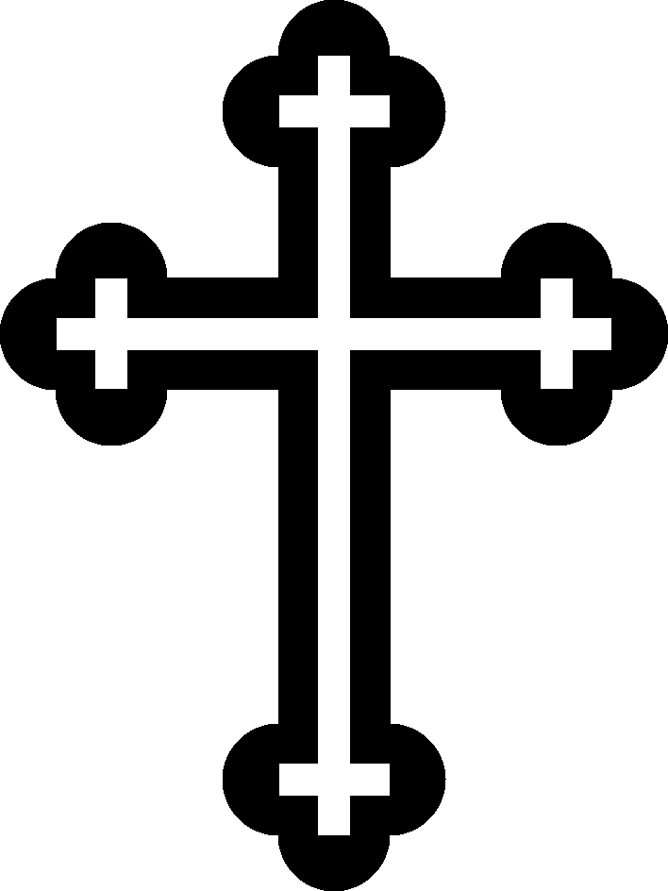

Slide 10
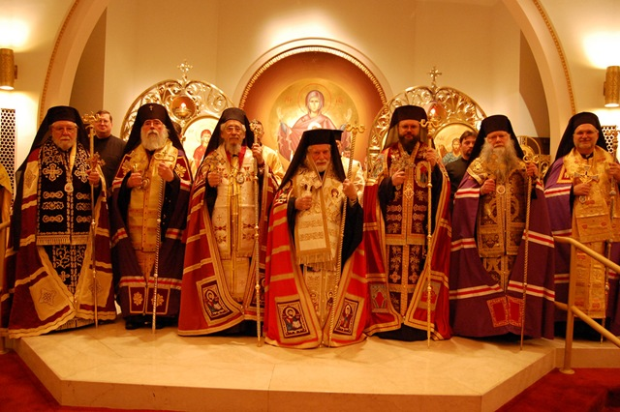

Slide 11
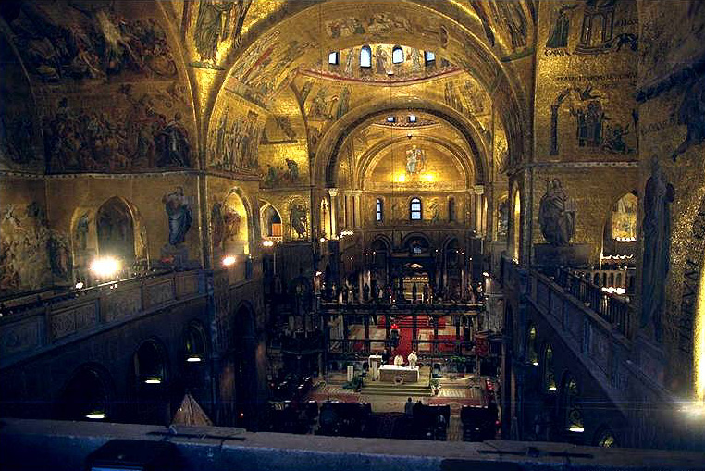

Slide 12
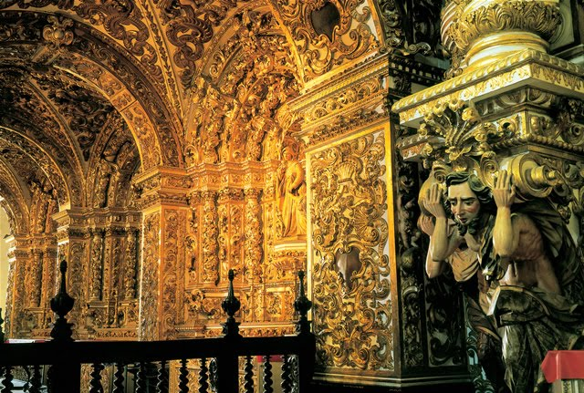
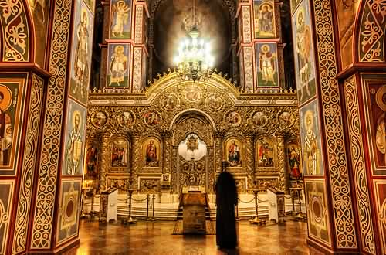

Slide 13
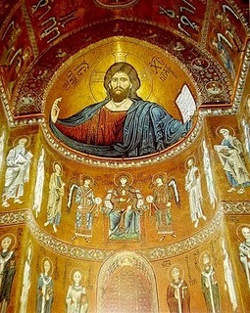
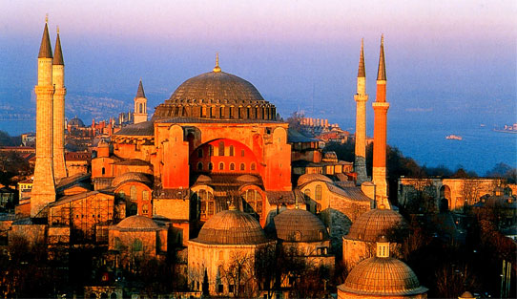
Hagia Sophia
Hagia Sophia is a former Greek Orthodox patriarchal basilica, later an imperial mosque, and now a museum in Istanbul, Turkey.

