Slide 1
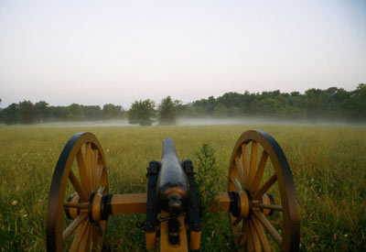
THE WAR COMES TO AN END

Slide 2
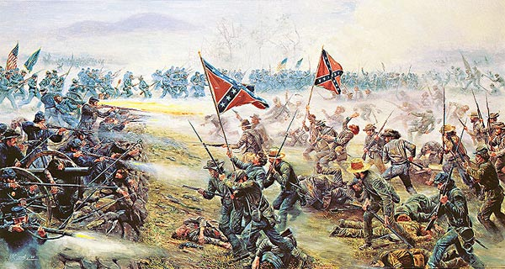
Battle of Gettysburg
Turning point against the Confederates
Lasted 3 days
7,500 soldiers died
Last battle fought on Northern soil

Slide 3
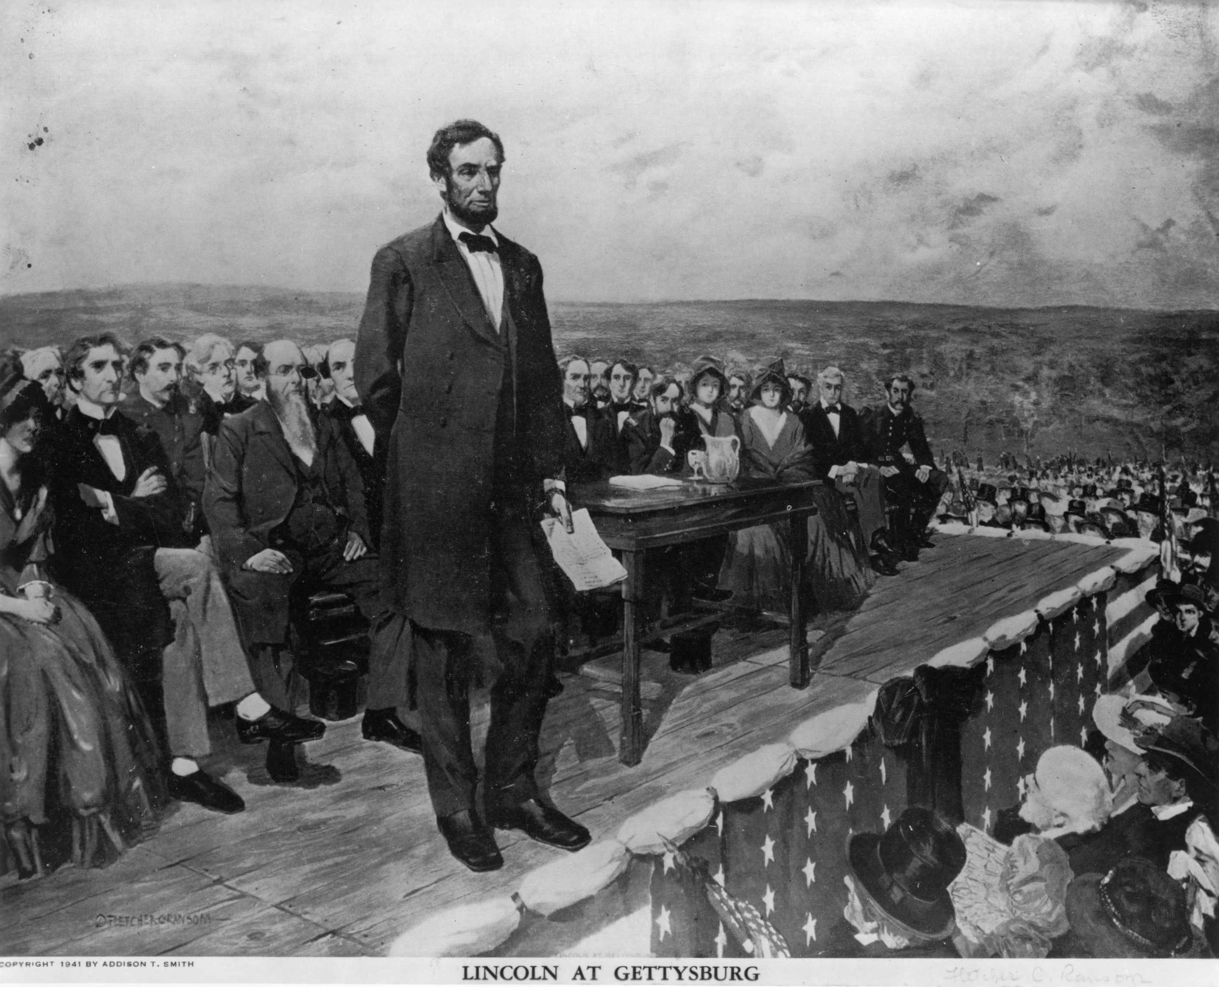
Gettysburg Address
Dedication Ceremony; Nov 19, 1863
Famous speech by Abraham Lincoln
Praised the bravery of Union soldiers
Renewed the North’s commitment to winning the Civil War
Short, but moving

Slide 4
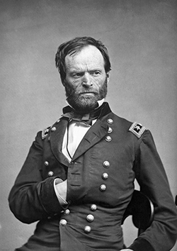
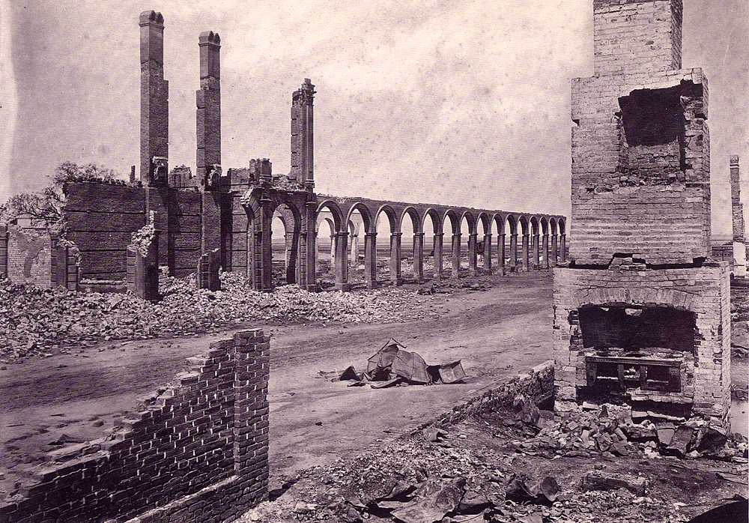
Sherman’s March
To win re-election Lincoln need a victory
General William Tecumseh Sherman carried out the Union’s plan to destroy Southern railroads and industries
Sherman marched south from Tennessee with 10,000 troops to take Atlanta, Georgia
Much of the city was destroyed— path of destruction was 60 miles wide
Ordered any residents to leave
Practiced total war
Destroying civilian resources: RR’s, bridges, crops, livestock, burned plantations, freed slaves.
Sherman’s March led to resentment for generations

Slide 5
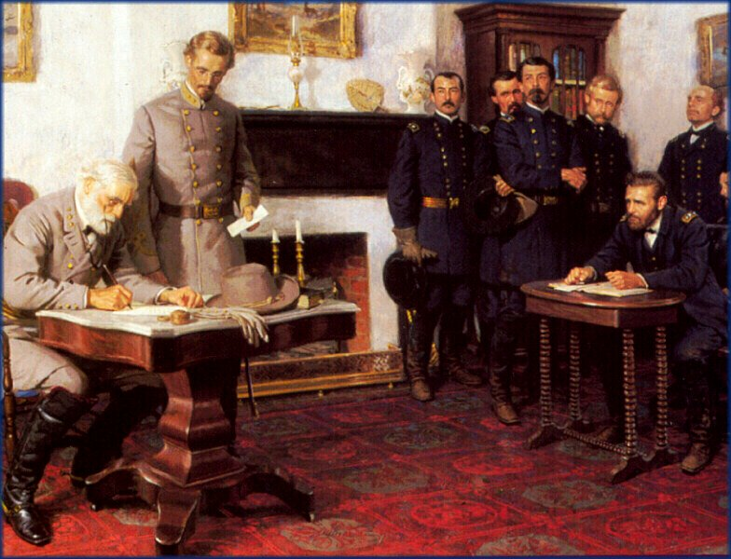
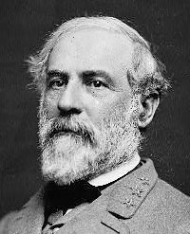
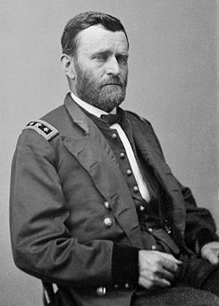
South Surrenders
Ulysses S. Grant closes in on Robert E. Lee’s army and demanded surrender
“There is nothing left for me to do, but go and see General Grant….and I would rather die a 1,000 deaths.”
April 9, 1865
At the home of Wilmer McClean in the village of Appomattox Court House, Virginia.
Lee officially surrenders to Grant

Slide 6
The Surrender
Grant described the scene as sad and depressing
Commanded his soldiers to stop cheering because the South is their countrymen again

Slide 7
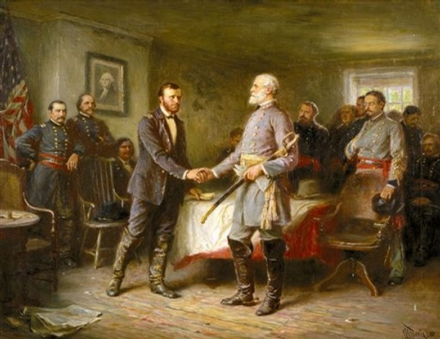
Effects of the War
620,000 lives lost in 4 years
Slavery ended, but majority of slaves had no jobs or homes
The southern economy was ruined
Hostility between North and South remained for generations

Slide 8
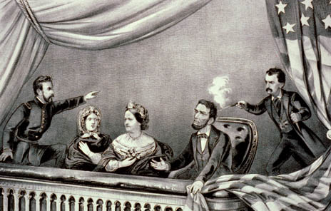
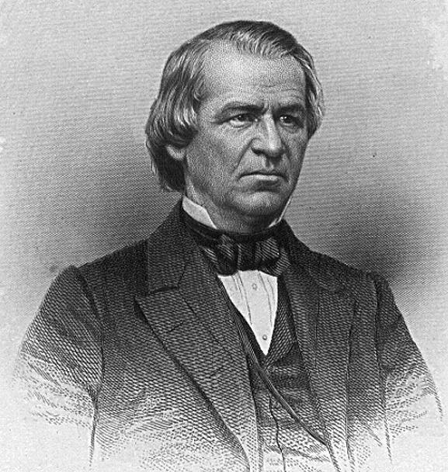
Lincoln’s Death
Abraham Lincoln died 5 days later
Shot in the Ford Theater, Washington D.C. during a play
John Wilkes Booth; southerner was responsible for his death
Andrew Johnson sworn in

